Slide 1
Lecture 10
Looking inside Cities: Spatial Structure and Neighborhood
10.3 Spatial Structure of Socioeconomic Quantities: Neighborhood Effects
©Luís M. A. Bettencourt 2024
IUS 6.1
Notes:
As mentioned in the previous module, we now look at the neighborhoods (space based communities) in cities. This is a subject of great historical interest, especially in sociology. Its study is also being made possible by more disaggregated and better quality data, which we will introduce here as well.

Slide 2
Looking Inside Cities
in space

Slide 3
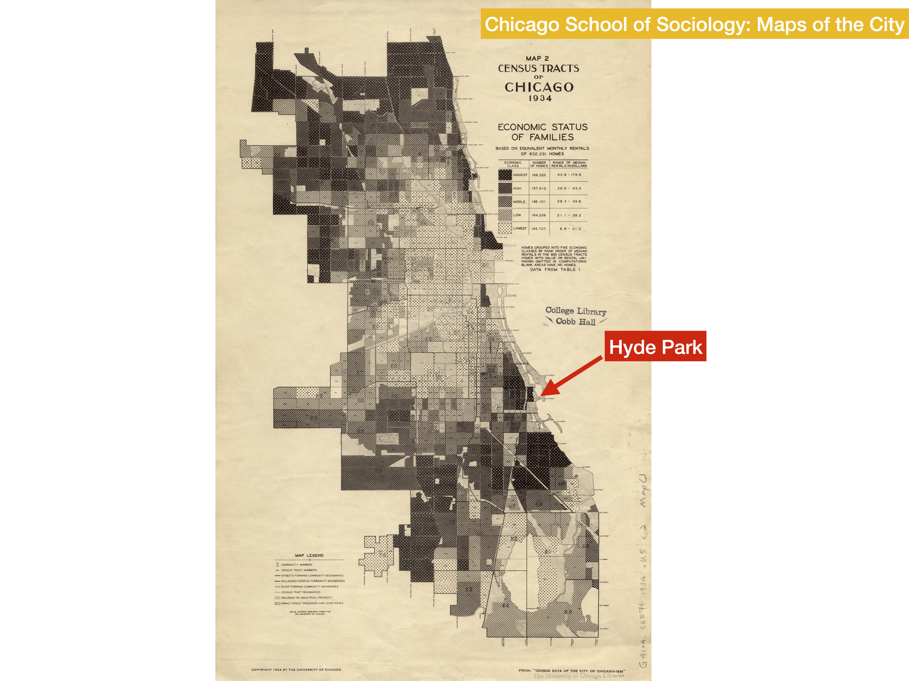
Notes:
In Chicago, there is a long tradition (for the last 100 years) of analyzing the city spatially and showing the character of different communities and neighborhoods. This map show a very different city from what it is today, for example with a rich South Side.

Slide 4
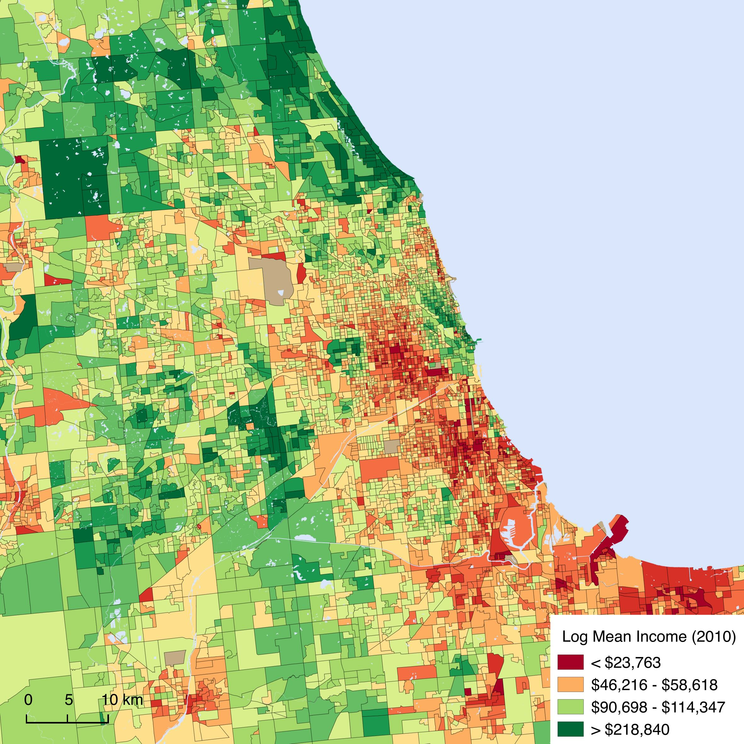
Income by Neighborhood
Chicago 2010
Hyde Park
Notes:
This is what the city looks like today. In Chicago people emphasize the concentrated poverty and racial segregation in the South and West Sides, which also show up in red on these maps. The North side is generally richer, while suburbs vary. The point is that this is actually a very complex pattern, with structure at different scales.

Slide 5
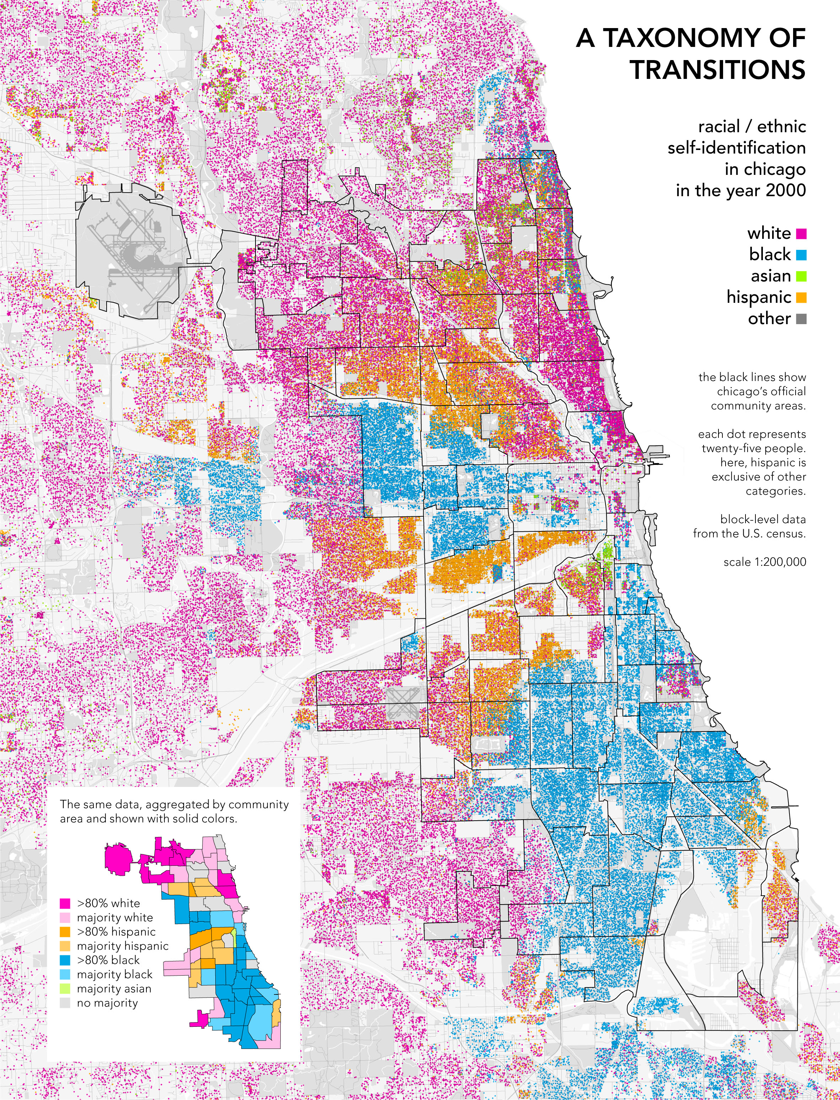
credit:radical cartography
Notes:
This is a map of Chicago by race. Note that most central areas, as well as Hyde Park are quite mixing.

Slide 6
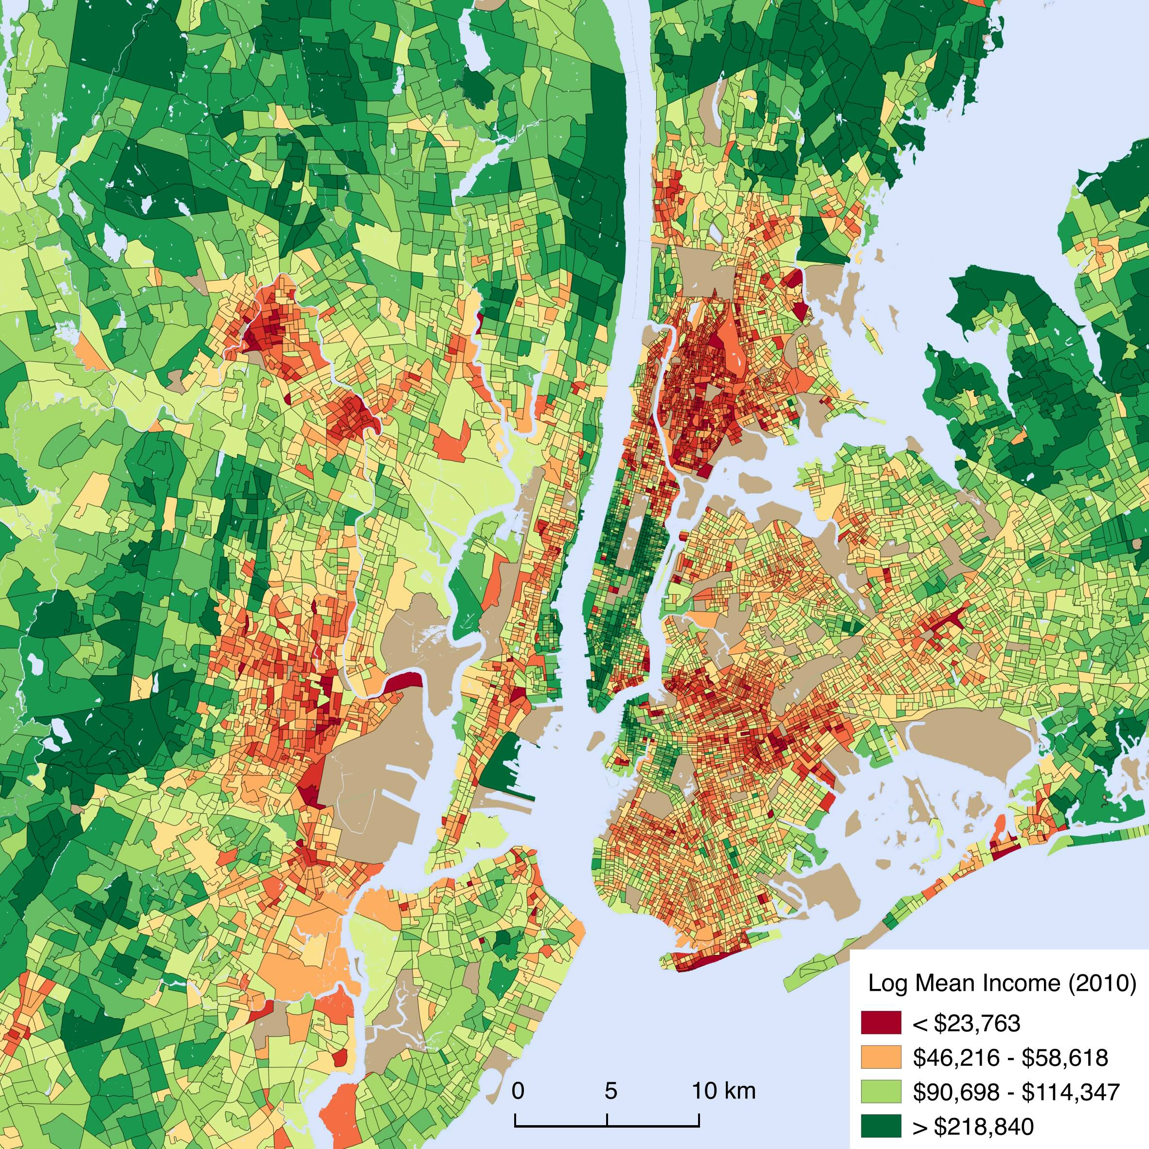
Income by Neighborhood
NYC 2010
Notes:
This is the similar picture for part of NYC: Note the contrast between Manhattan and the Bronx, and that Queens is quite middle class by income…

Slide 7
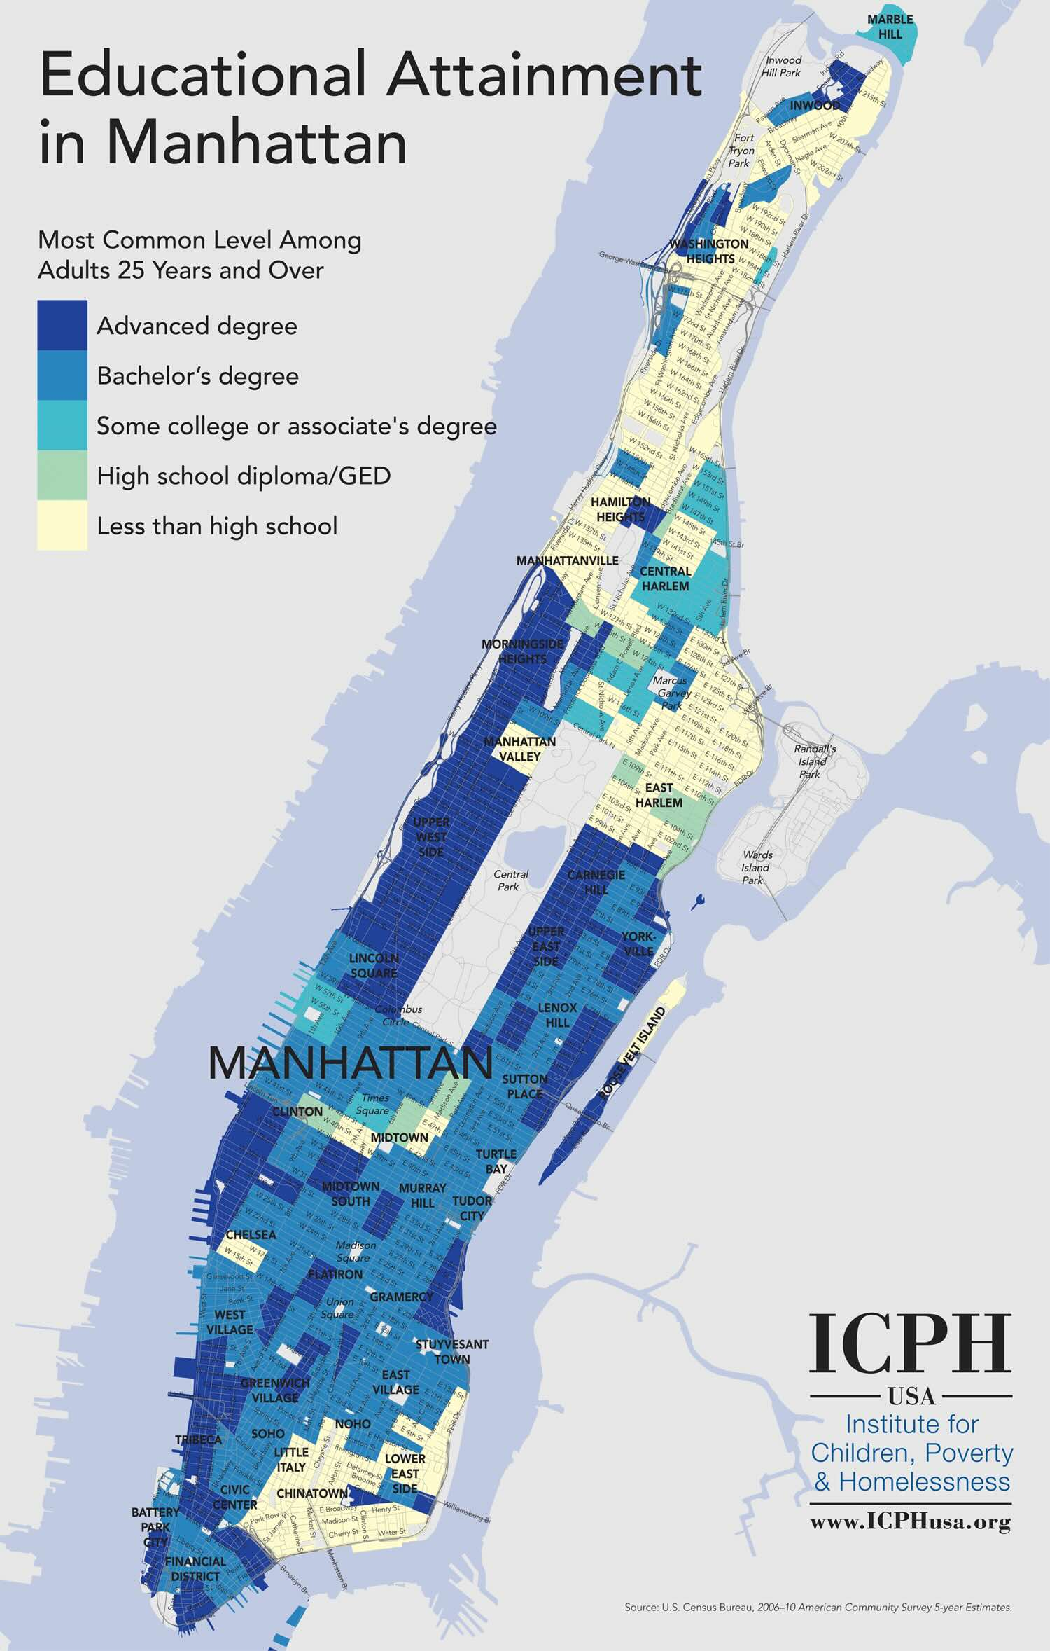
Notes:
This is just a map I borrowed about education attainment, so there can be inequalities of many kinds …

Slide 8
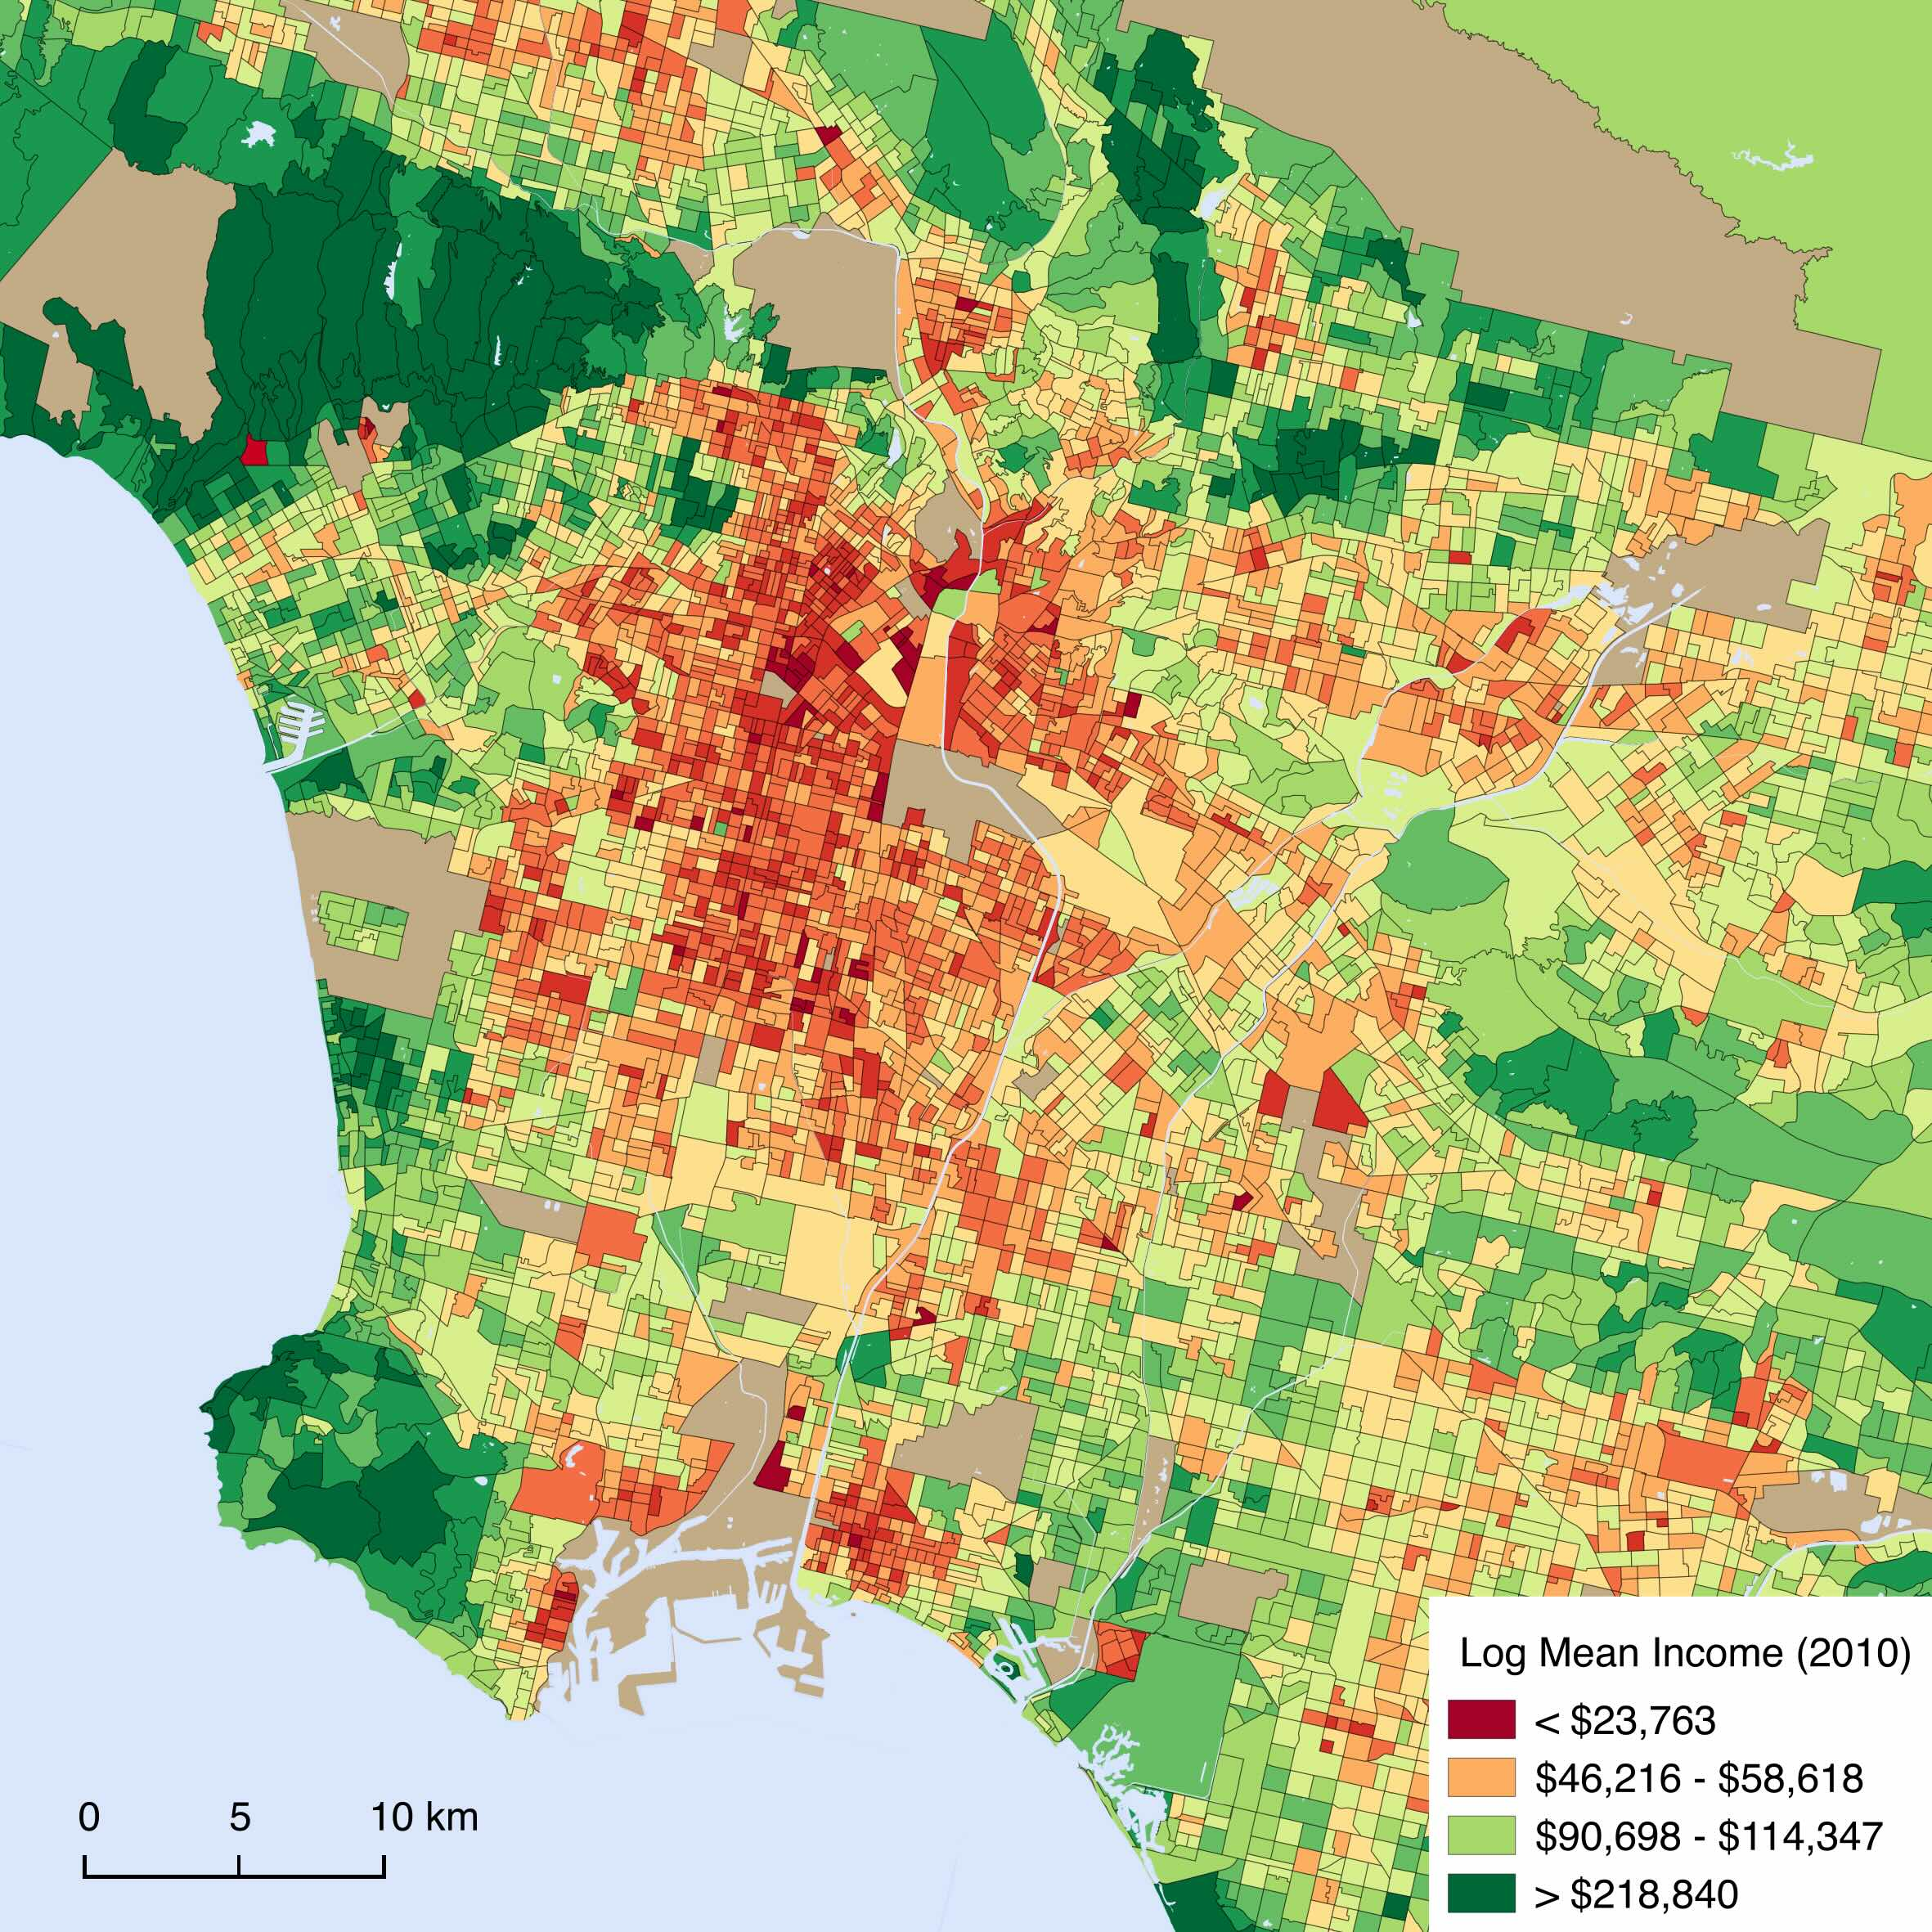
Income by Neighborhood
LA 2010
Notes:
Same think for Los Angeles

Slide 9
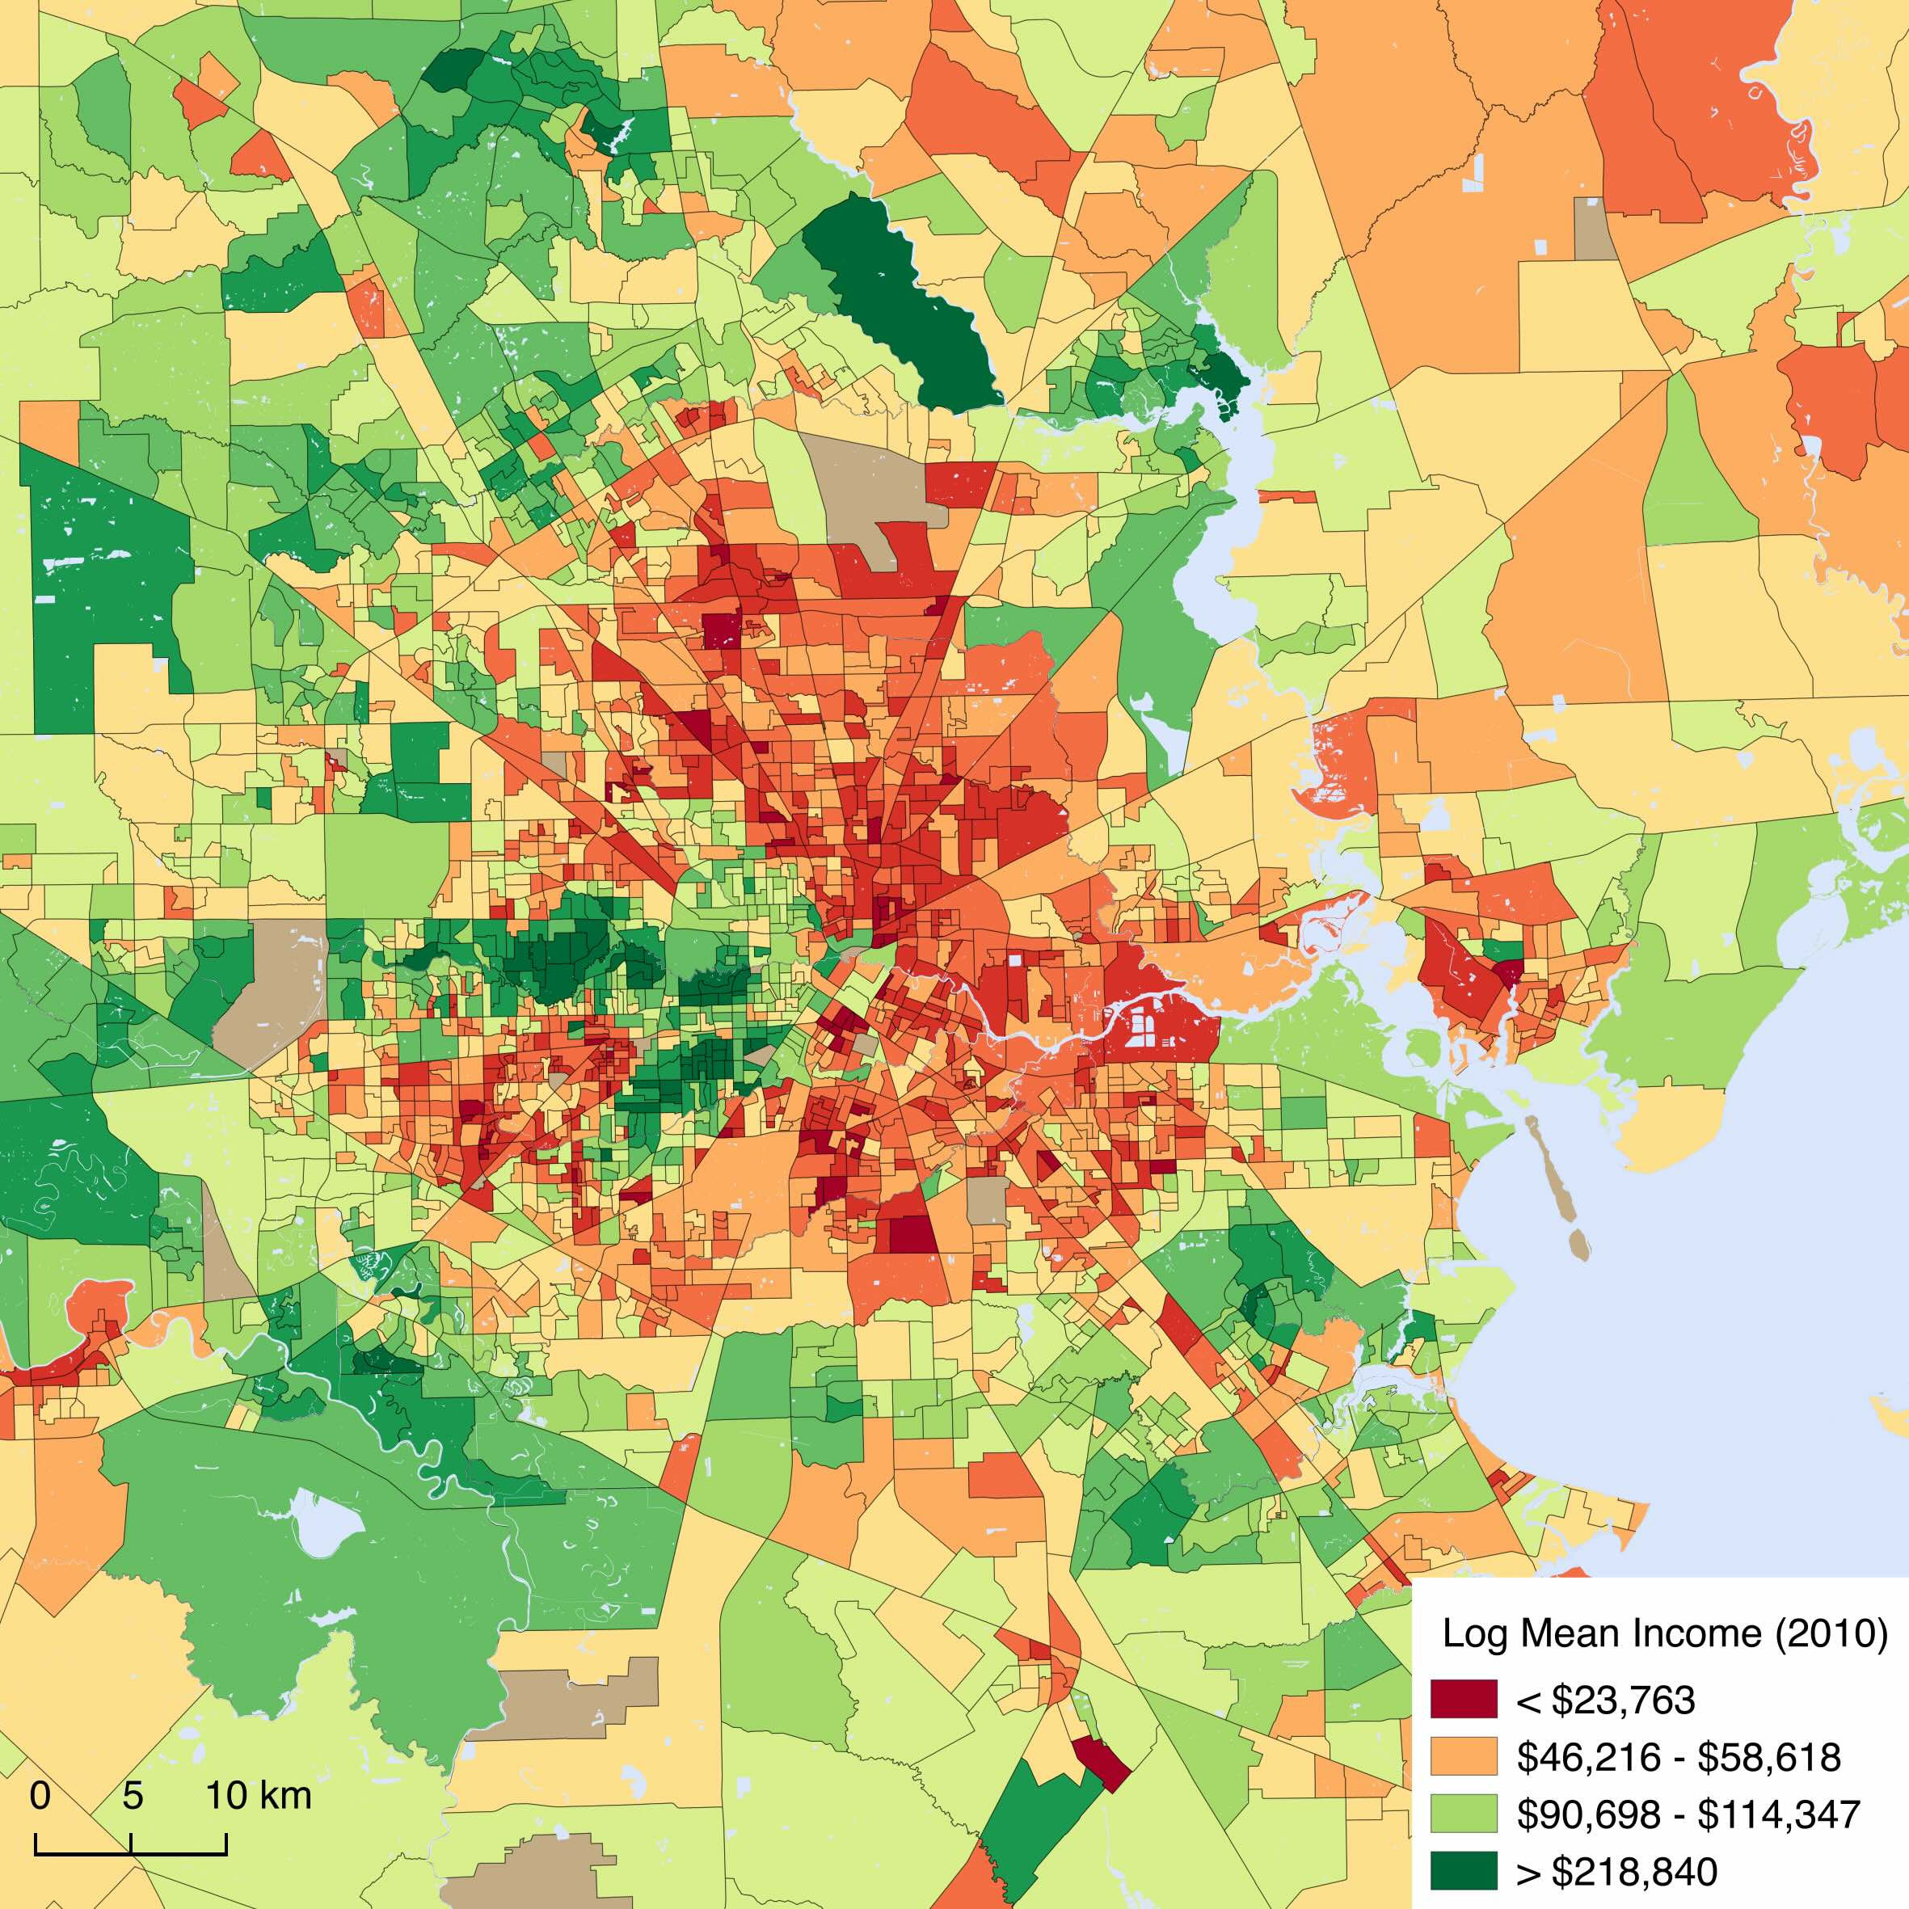
Income by Neighborhood
Houston 2010
Notes:
Houston…

Slide 10
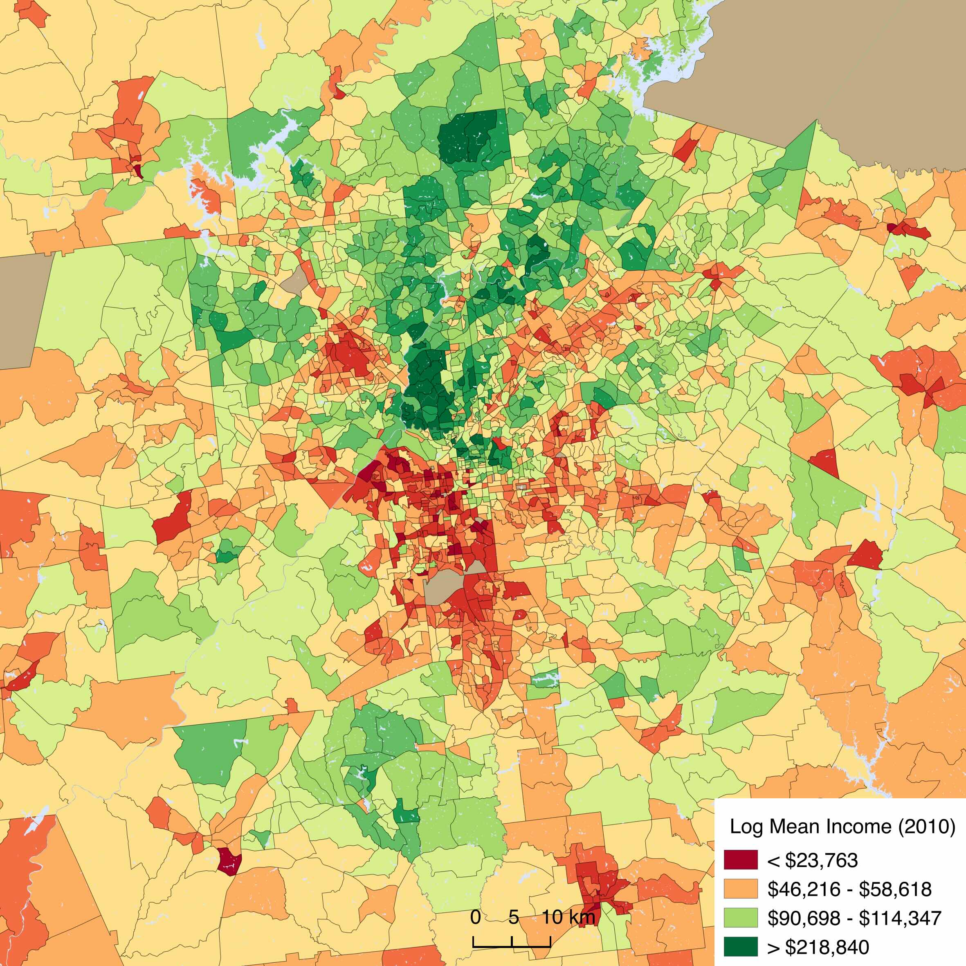

Income by Block Group
Atlanta 2010
neighborhood
“polarization”

Slide 11
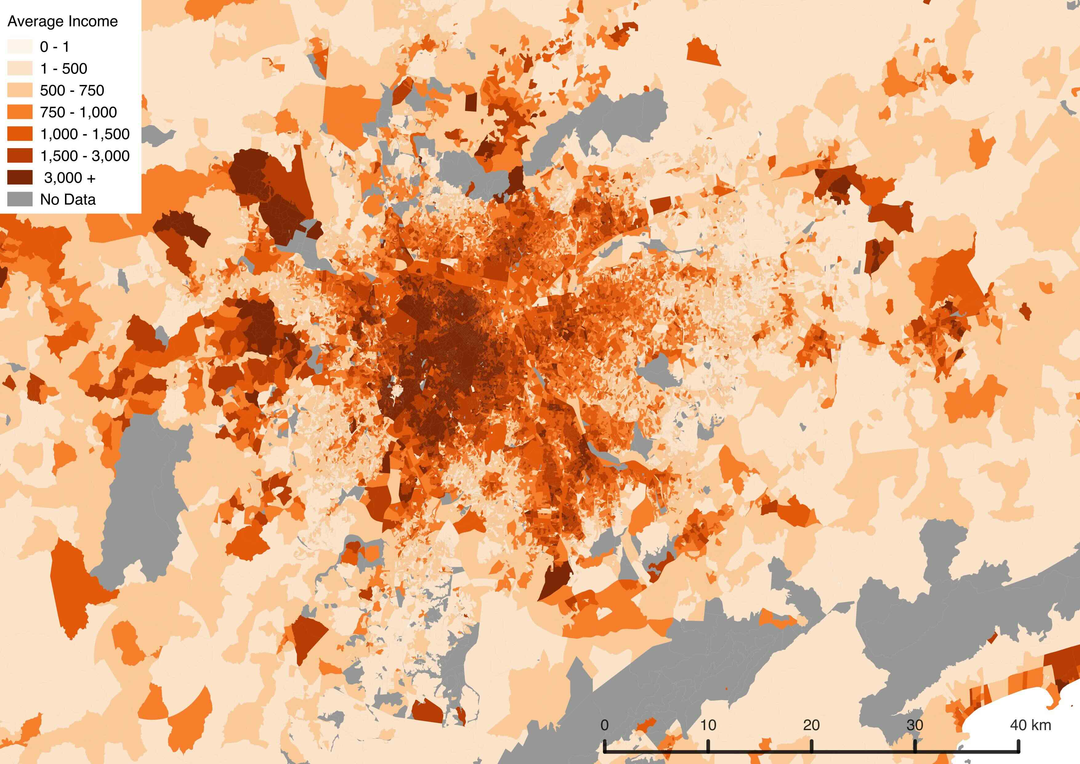
Income by Neighborhood
São Paulo 2010
Notes:
And Sao Paulo, Brazil, where most wealth is central to the city.

Slide 12
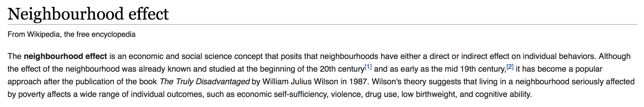
Neighborhood Effects
Chicago School of Urban Sociology
“Ecological” Effects
Notes:
One important consequence of local environments in cities are so-called “Neighborhood effects”. The idea is that the place where people grow up, live and socialize have effects on individuals, not just circumstantially but also throughout the life course. This idea crystalized during deindustrialization, impoverishment and increased racial segregation in Chicago neighborhoods in the 1980s. It also follows a general idea from the older Chicago school that neighborhoods are ecologies, influencing individuals as they adapt to them, both positively and negatively.

Slide 13
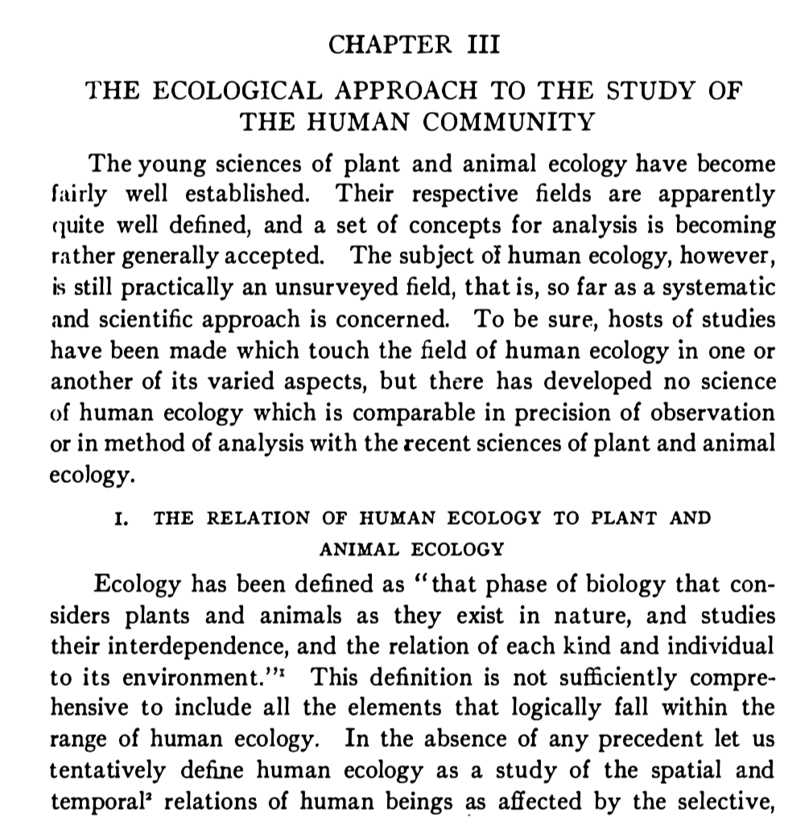
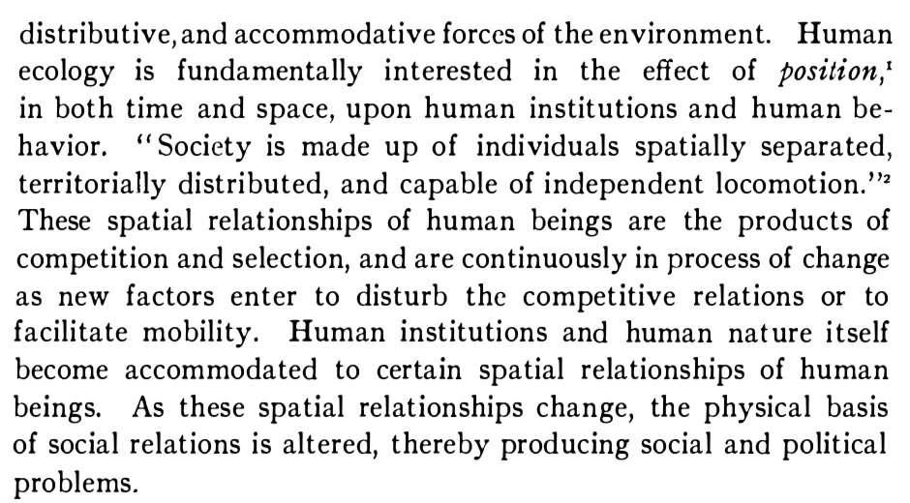
“Ecological” Effects
Roderick D. McKenzie
The City
Notes:
Here’s some early ideas from Park + Burgess, The city.

Slide 14
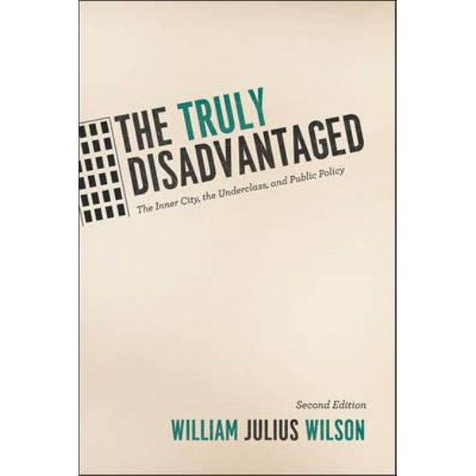
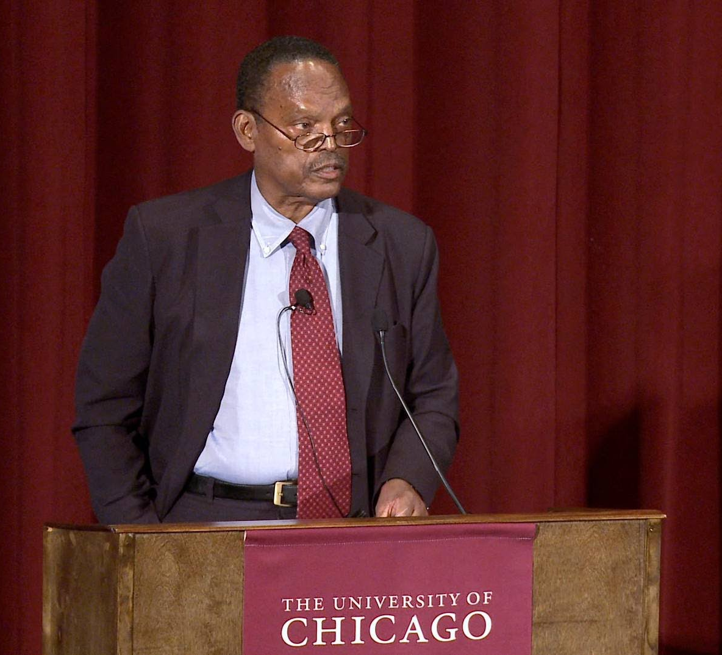
William Julius Wilson, 1987
https://sociology.fas.harvard.edu/people/william-julius-wilson
In ''The Truly Disadvantaged,'' Mr. Wilson takes on conservatives, liberals and civil rights leaders alike as he develops persuasive alternative explanations of what has gone wrong in the inner city and supports them with extensive data and research. For example, he explores the sharpening of class lines among blacks; the proportions of black men with annual incomes over $25,000 and those with annual incomes under $5,000 have both increased. Inequality of income is greater now among black families than among white families.
NYtimes review
https://press.uchicago.edu/ucp/books/book/chicago/T/bo13375722.html
This was also a response to the Moynihan report :
https://www.theatlantic.com/politics/archive/2015/09/the-moynihan-report-an-annotated-edition/404632/
Notes:
Back to the person who really advanced this idea: Bill Wilson (then at UChicago, now at Harvard).

Slide 15
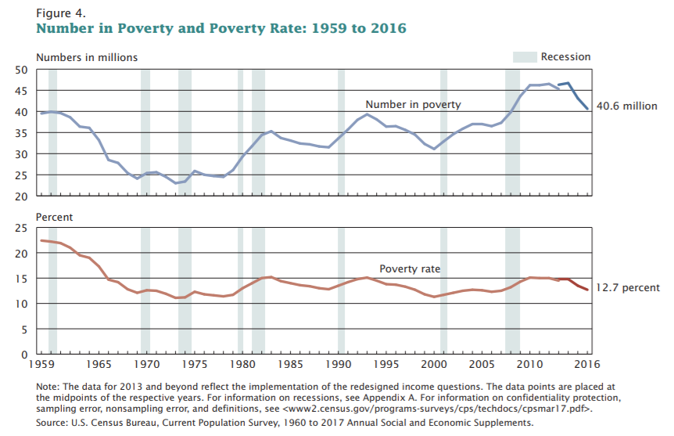
Notes:
The period in focus here starts around 1980, with deindustrialization, globalization, and changes in tax law and social services during the Reagan Administration. It is a period increased poverty, after the very positive trends of the post WWII.

Slide 16
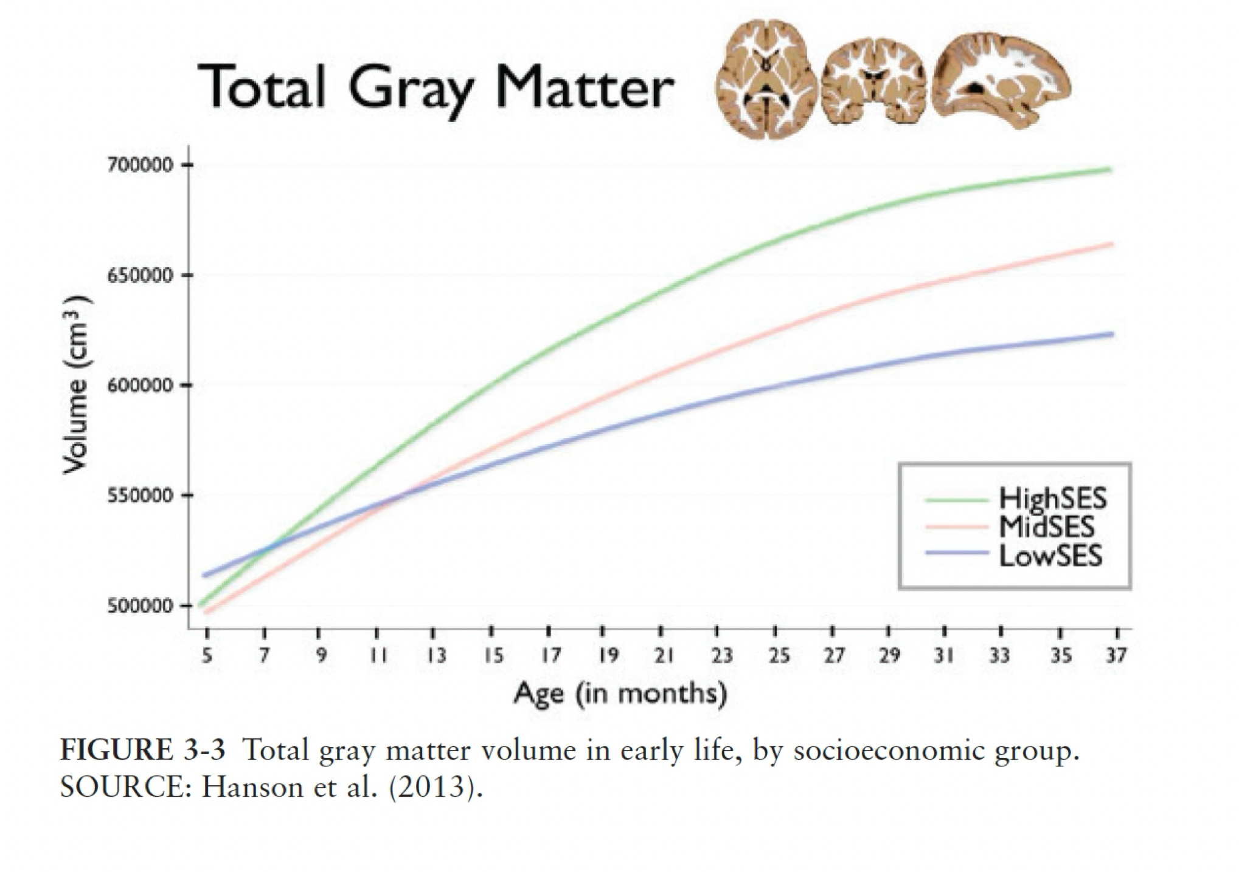
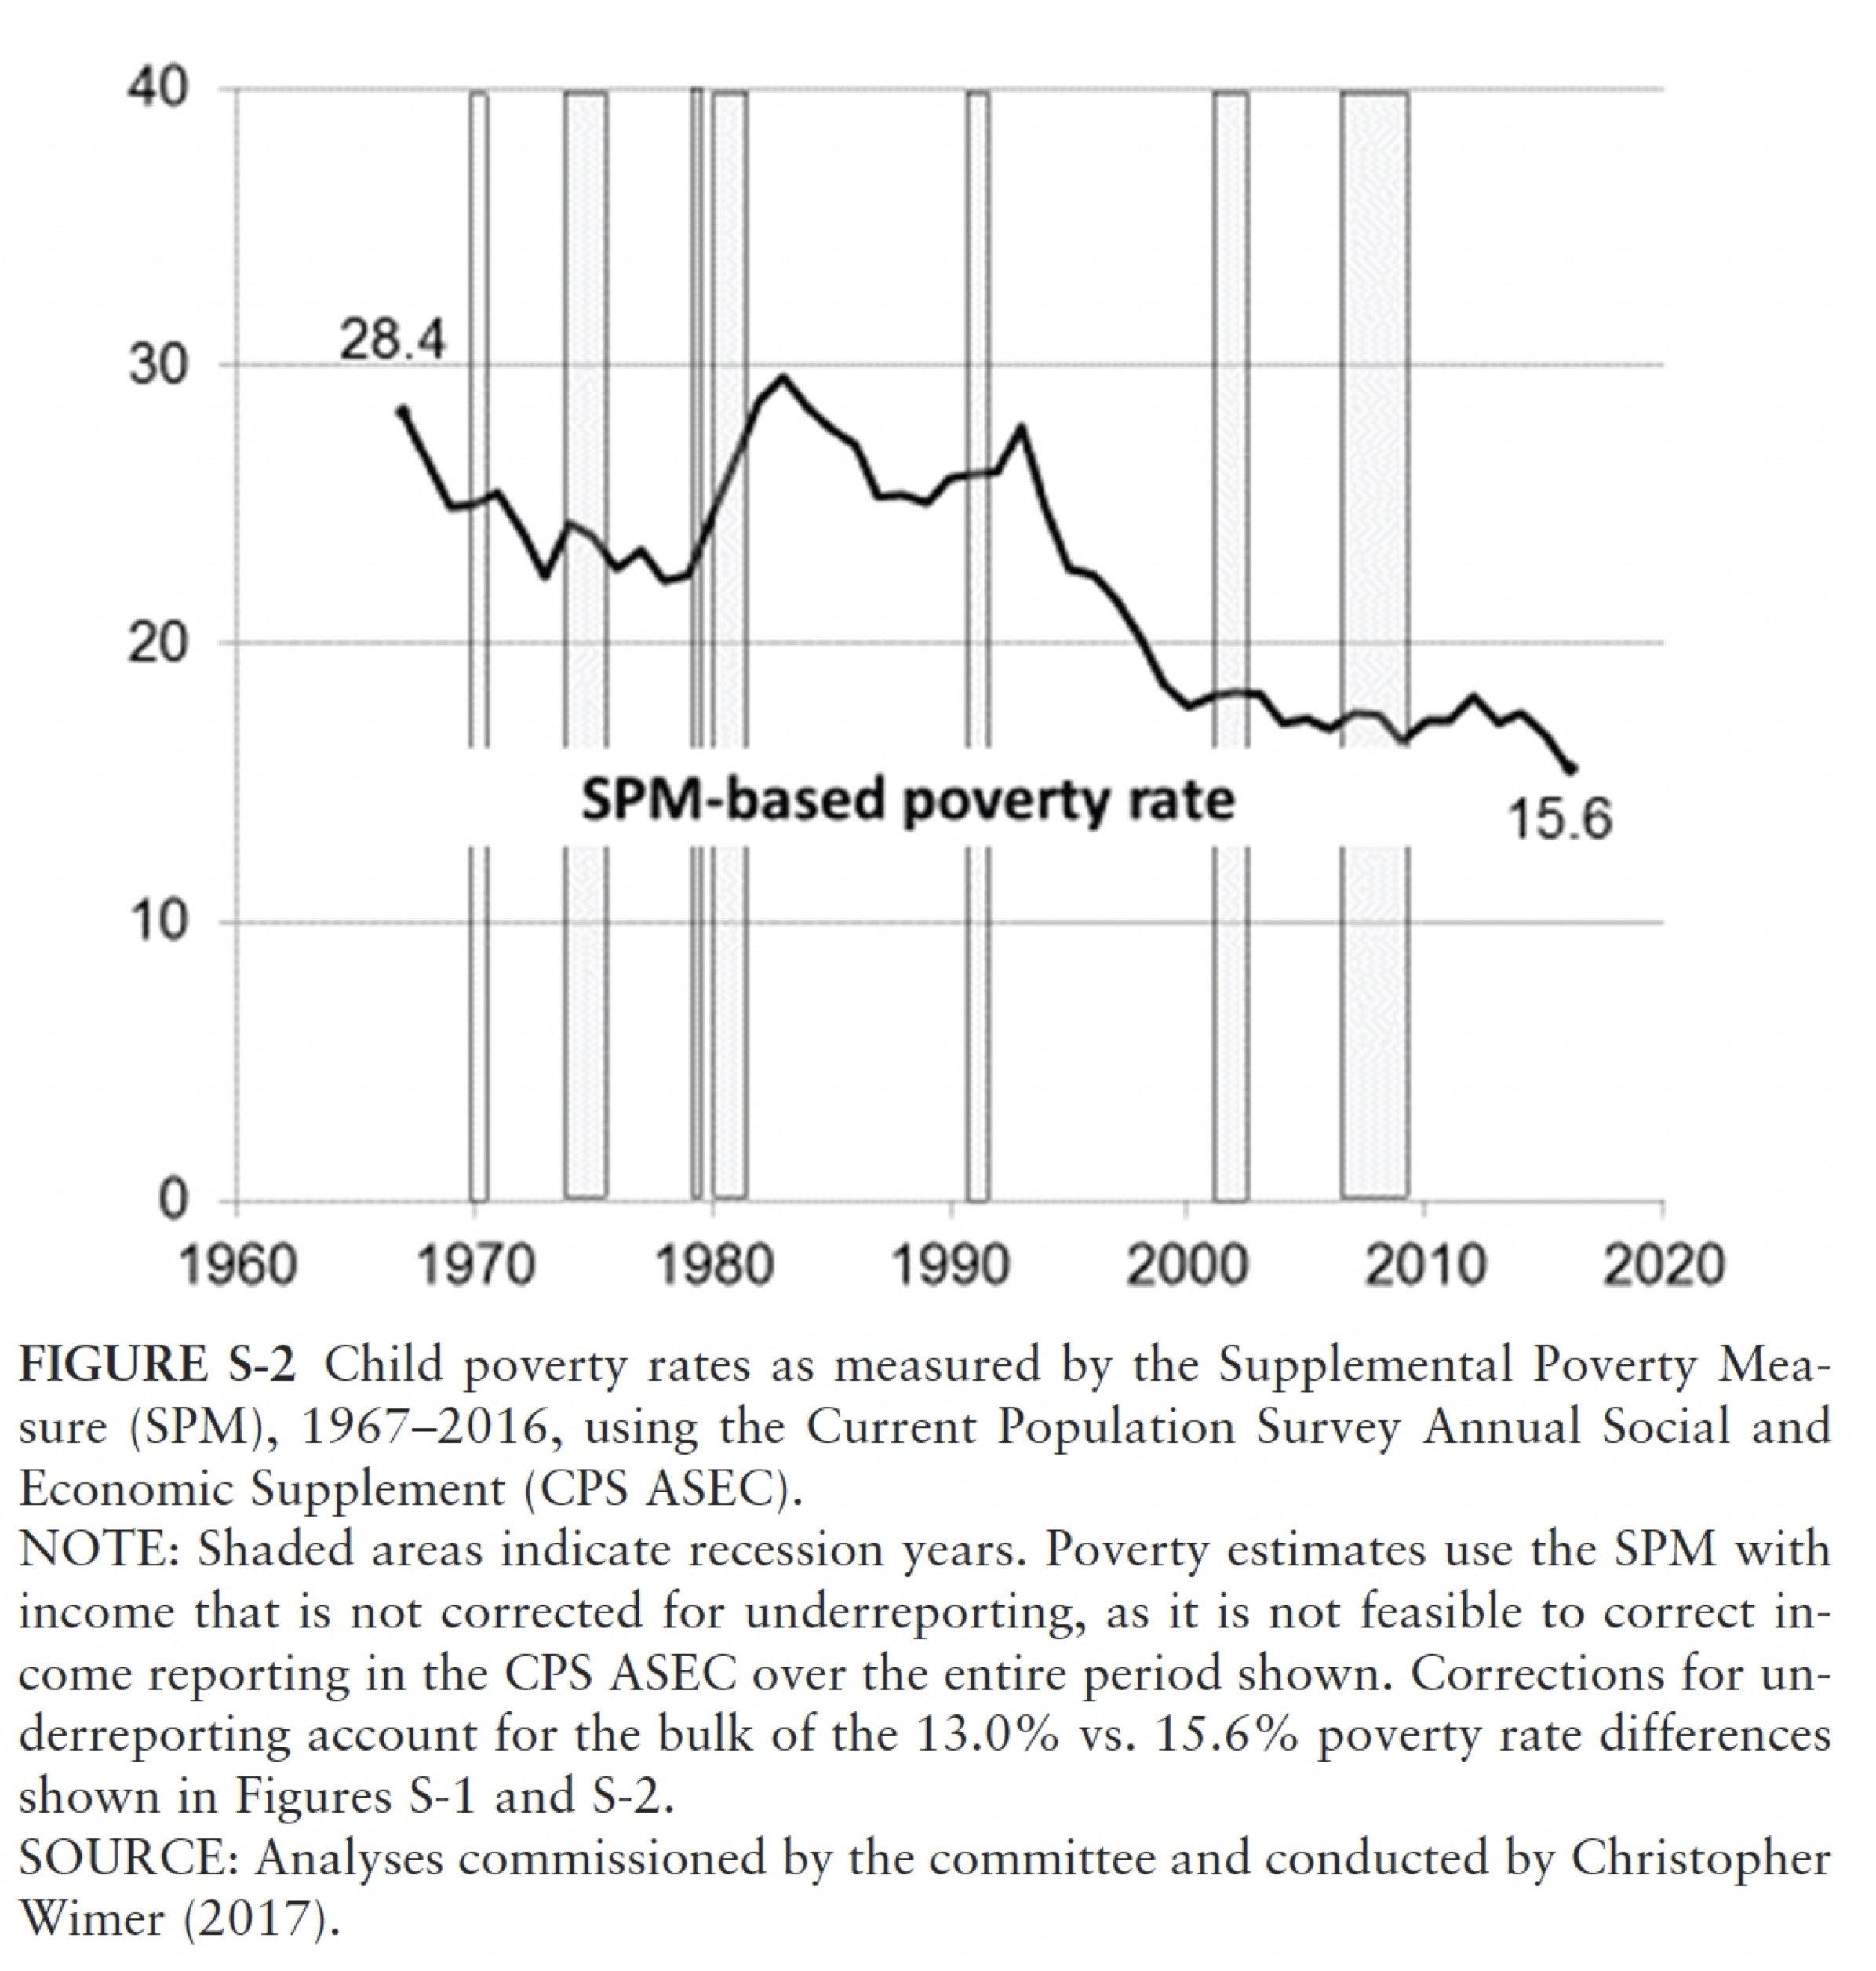
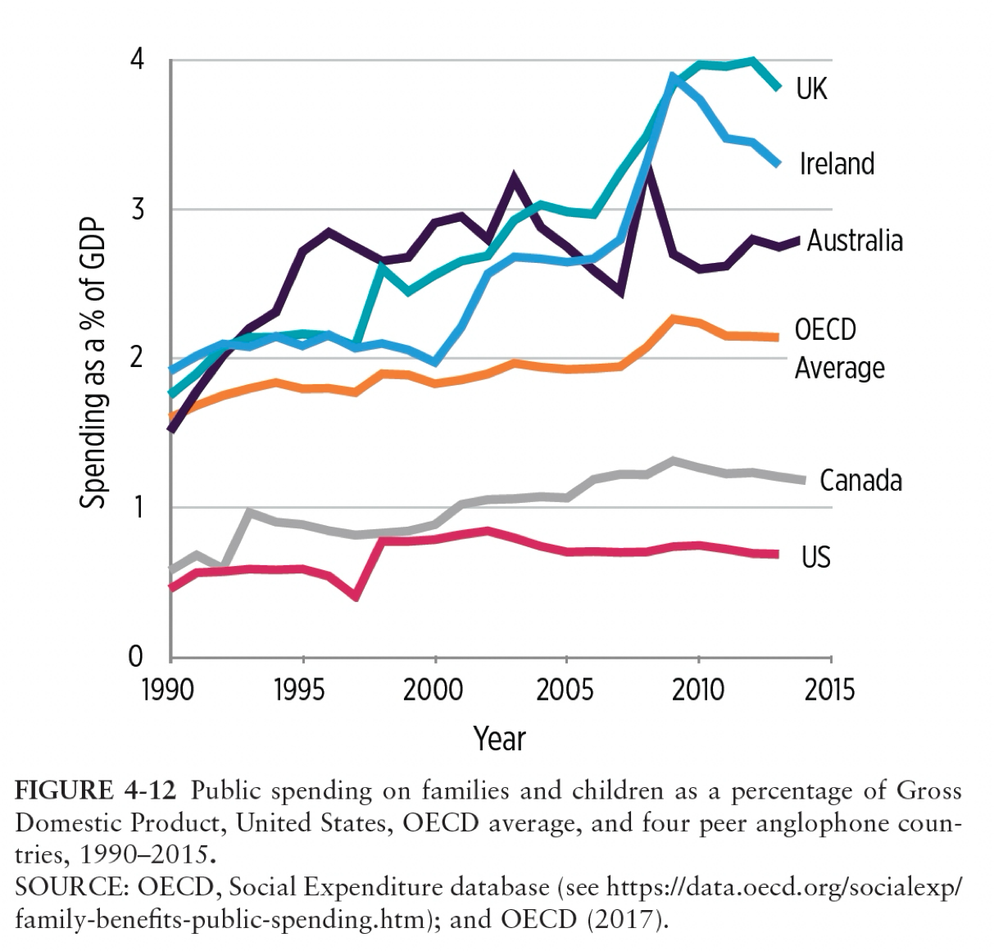
Poverty has long term consequences for people and society
https://www.nap.edu/catalog/25246/a-roadmap-to-reducing-child-poverty
Notes:
The permanent consequences of growing up in poverty are a theme of intense, and controversial, research, but there are now many different types of evidence that it can be stunting of both body and brain. The US is an outlier in its investments of people in situations of disadvantage, especially since 1980s.

Slide 17
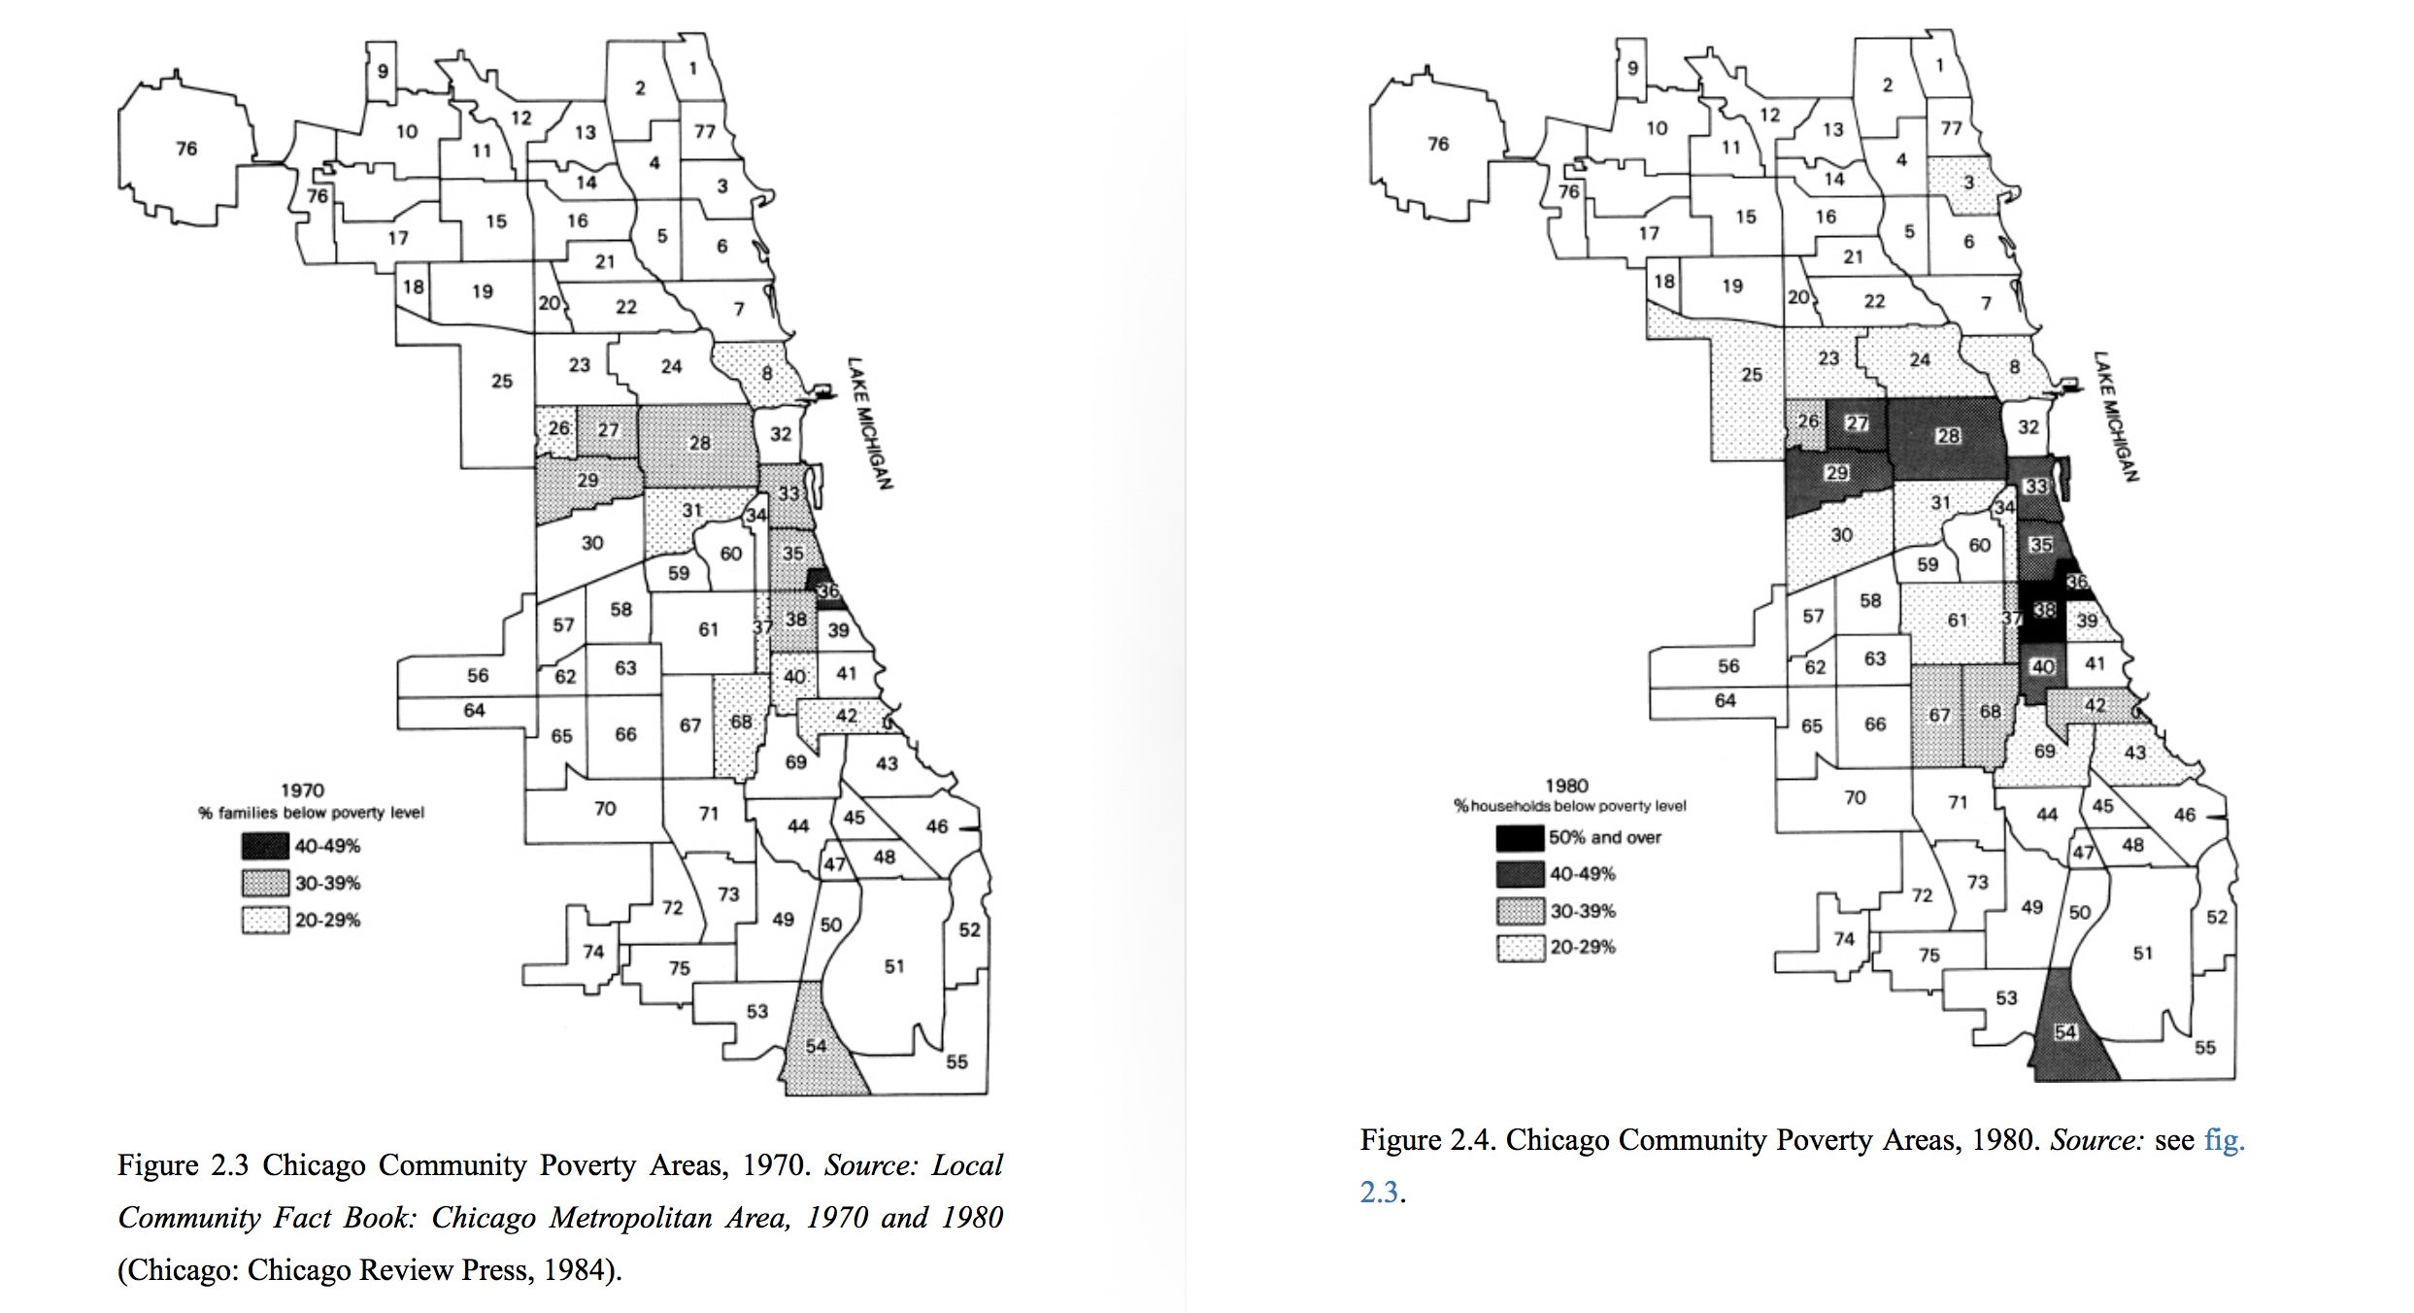
Notes:
These were the data used by Bill Wilson, of before and after poverty 1970-1980.

Slide 18
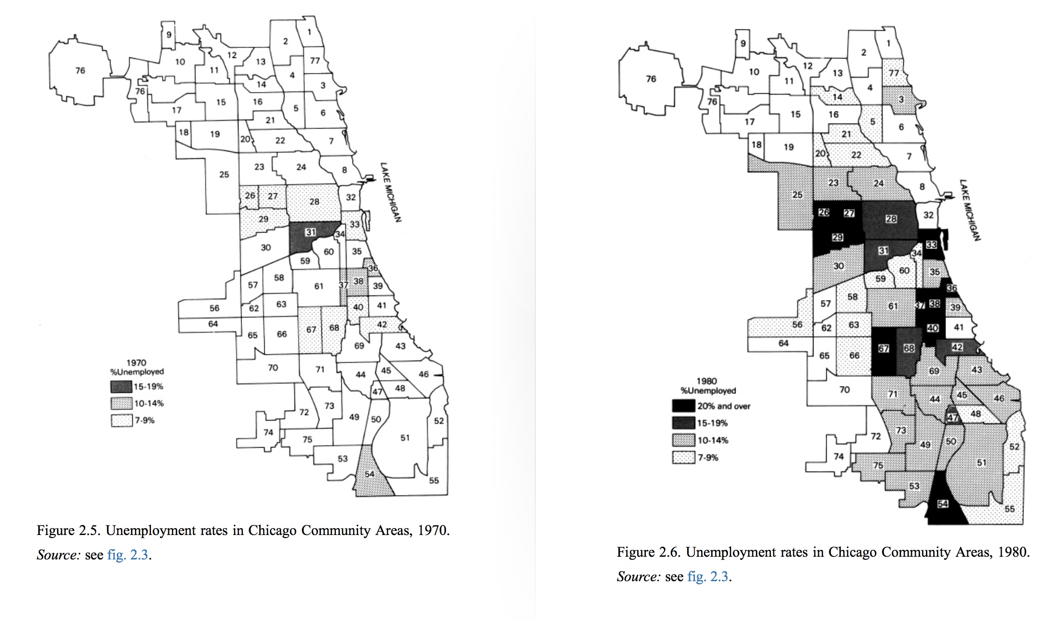
Notes:
And unemployment … the 1980 map starts to look like present maps of Chicago, with the South and West sides singled out. We could say that the present pattern of concentrated poverty and many other troubles was really created during this period and has not been reversed since, in almost 45 years … This is an example of an intergenerational change that has not been yet changed.

Slide 19
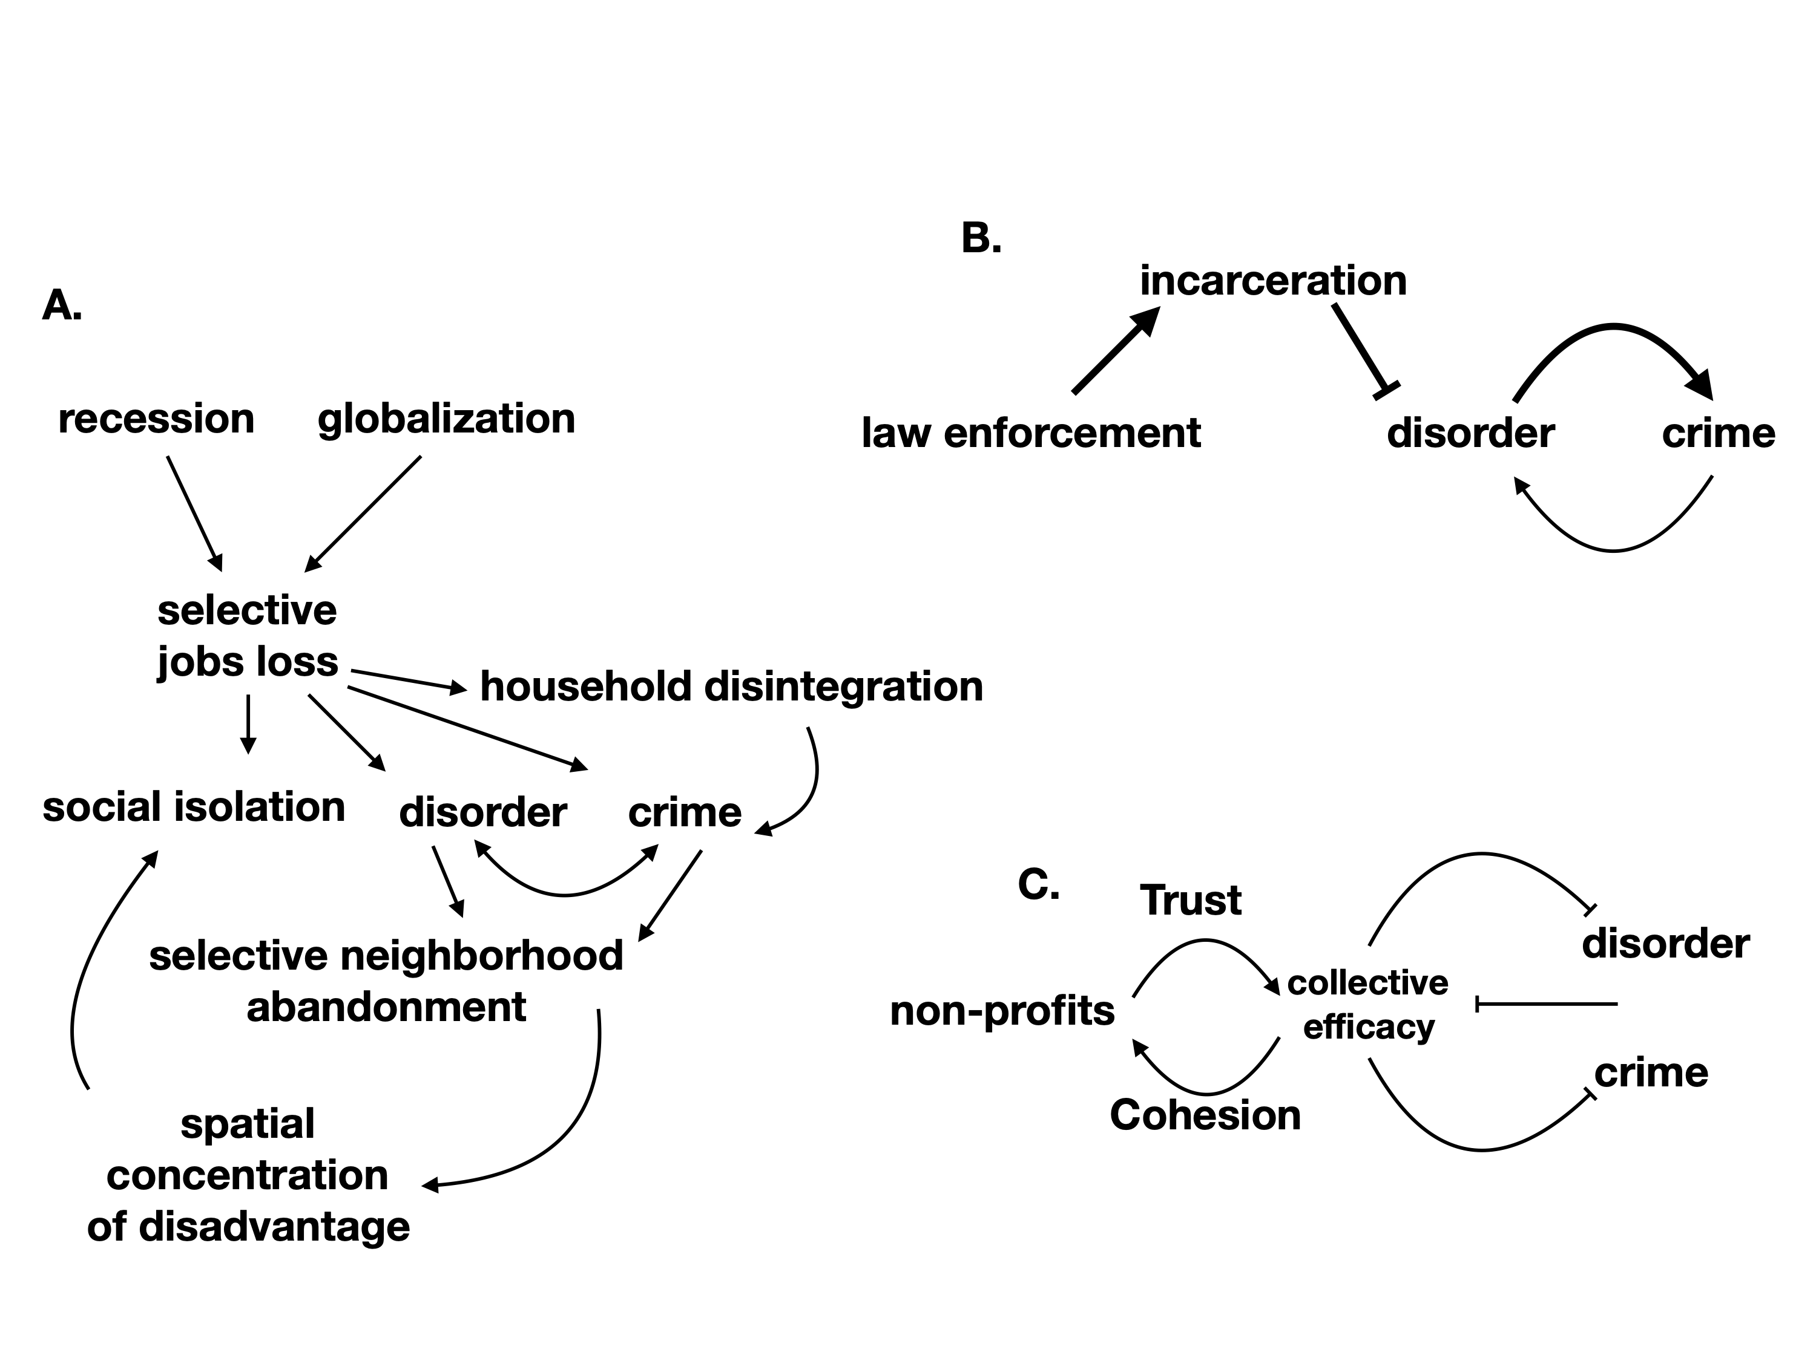

Broken Windows Theory
Wilson’s Model
by race due to history
Collective Efficacy Theory
Notes:
This slide needs keynote or powerpoint. It shows a causal diagram (mine, could set as exercise) of Wilson’s theory of neighborhood decay (remember the Jane Jacobs diagram). How can these vicious cycles be made to run backwards, as virtuous cycles? What external variables need to be affected? Likewise for broken window and collective efficacy, which once written as a diagram do not look so promising iIMO. The idea is to have students reason logically and clearly about systemic processes. This is rarely done in social theory, which tends to be verbal or input-output

Slide 20
Ecological Sociology
not individualistic determinants
such as race/ethnicity
no personal virtue or pathology
not structural determinants
no environmental determinist
(forces beyond our control)
racism / power / culture of poverty /culture of violence
Emphasis on dynamical co-adaptation between
people and (socioeconomic) environments
Notes:
Just a few words about these approaches to neighborhoods in that they emphasize the importance of environments on individuals, and are there fore “ecological”. They are different from rational choice theory, where there is no environment, and certainly not conditions affecting and shaping behavior differently for different agents. This way of thinking is also important in social and environmental psychology.

Slide 21
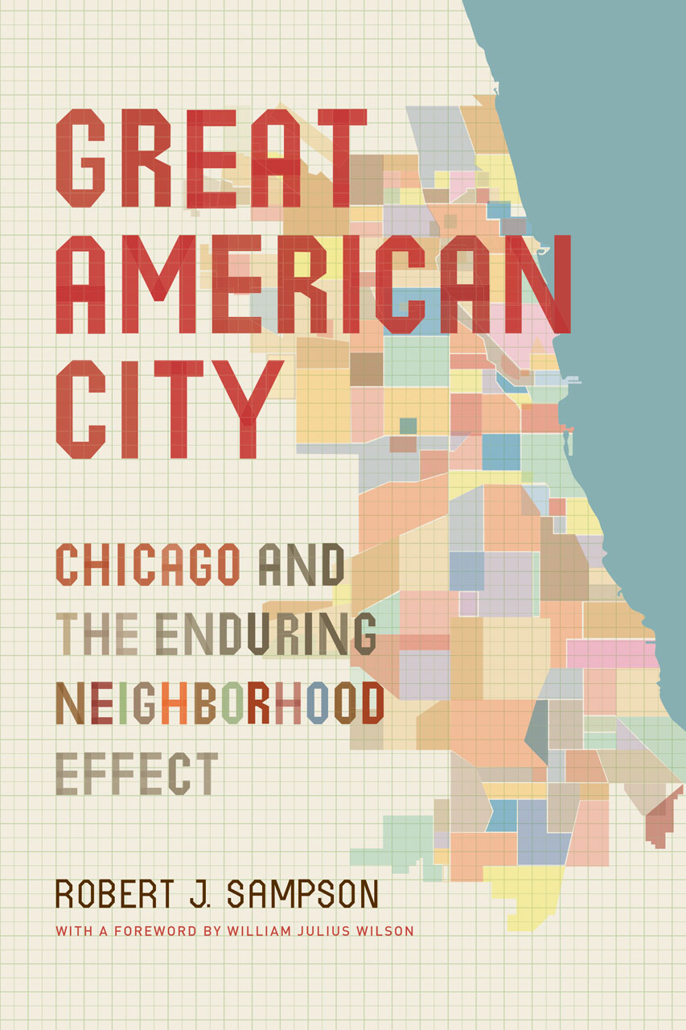

Robert J Sampson
“Ecometrics”
Ecological indicators in the city
https://press.uchicago.edu/ucp/books/book/chicago/G/bo5514383.html
Notes:
This way of thinking is summarized by Rob Sampson’s relatively recent book.

Slide 22
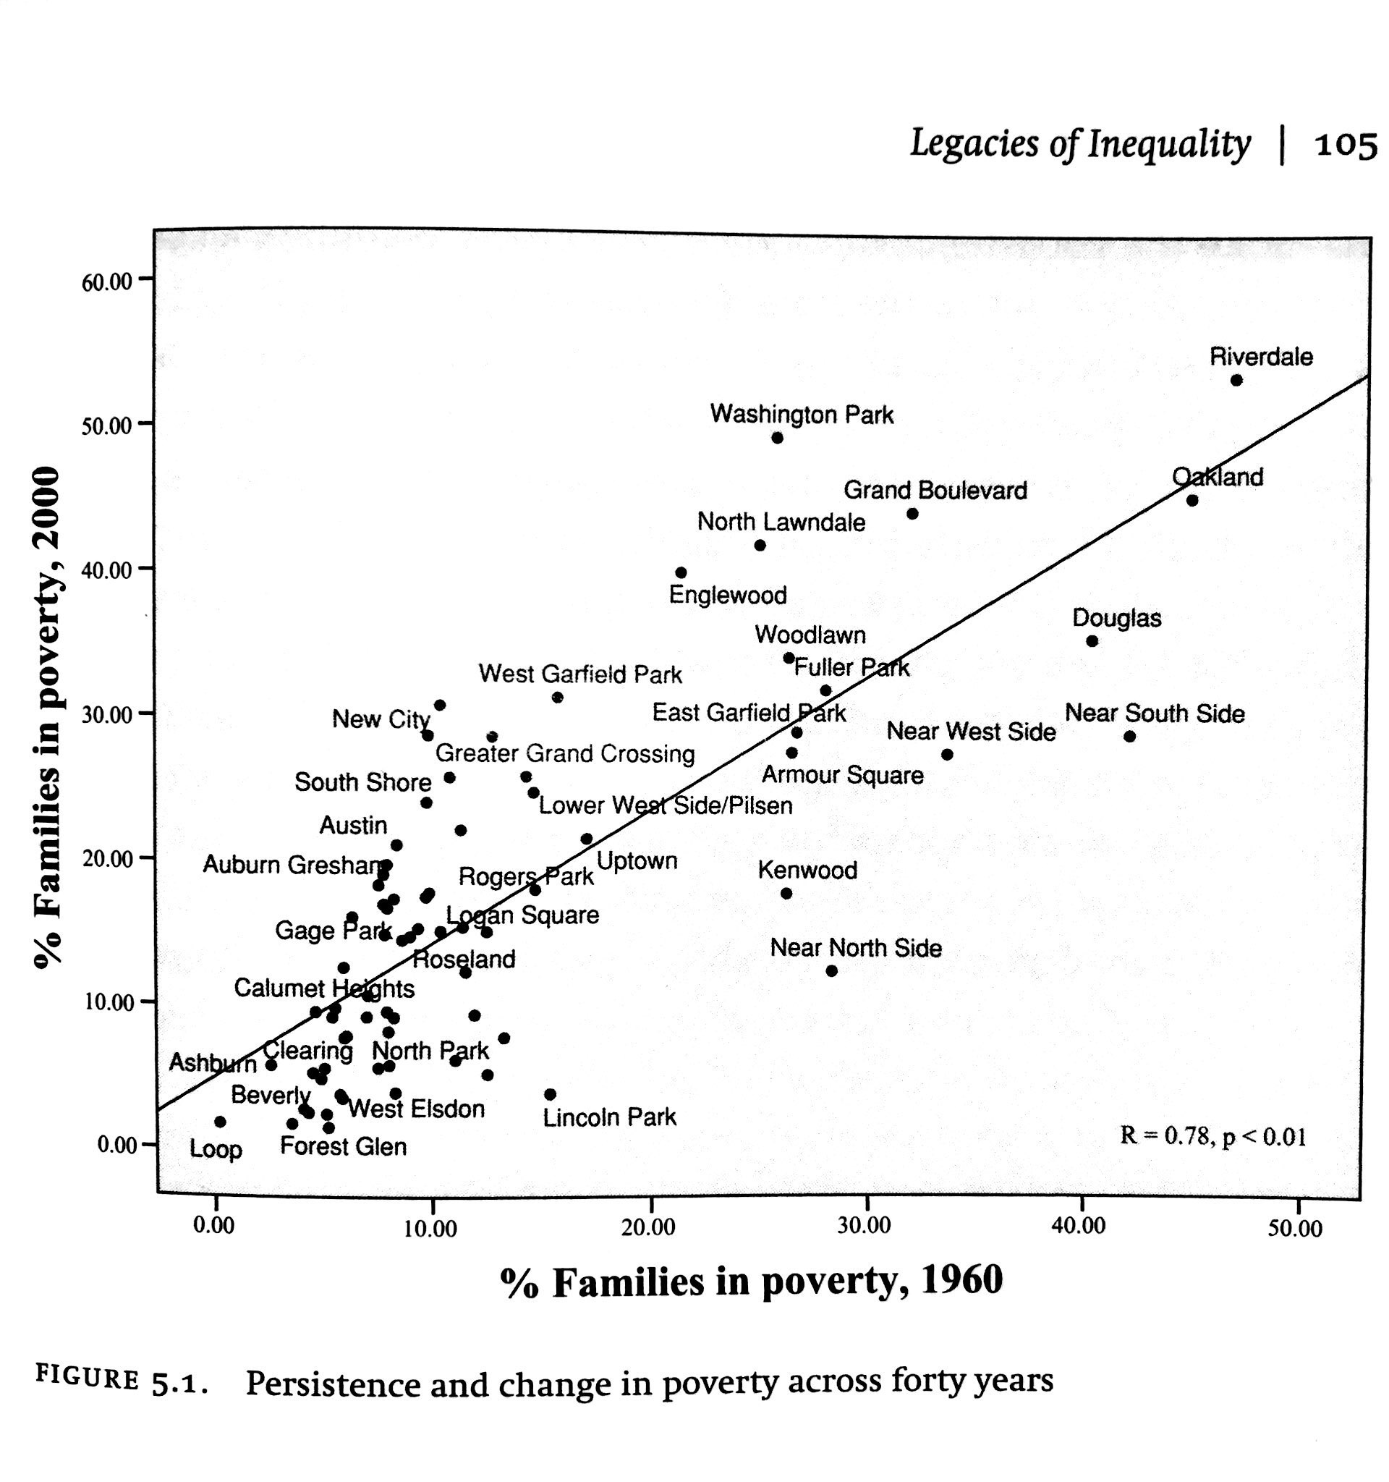
Persistence
despite total
population turnover
Notes:
Which has a number of interesting empirical illustrations. This one shows the persistence (again on a generational time scale) of poverty prevalence at the neighborhood level in Chicago. If you know Chicago, it is also interesting to focus on places furthest from the line, which either got much worse, or better over this period and the factors involved. It is also interesting to do this sort of analysis for other cities.

Slide 23
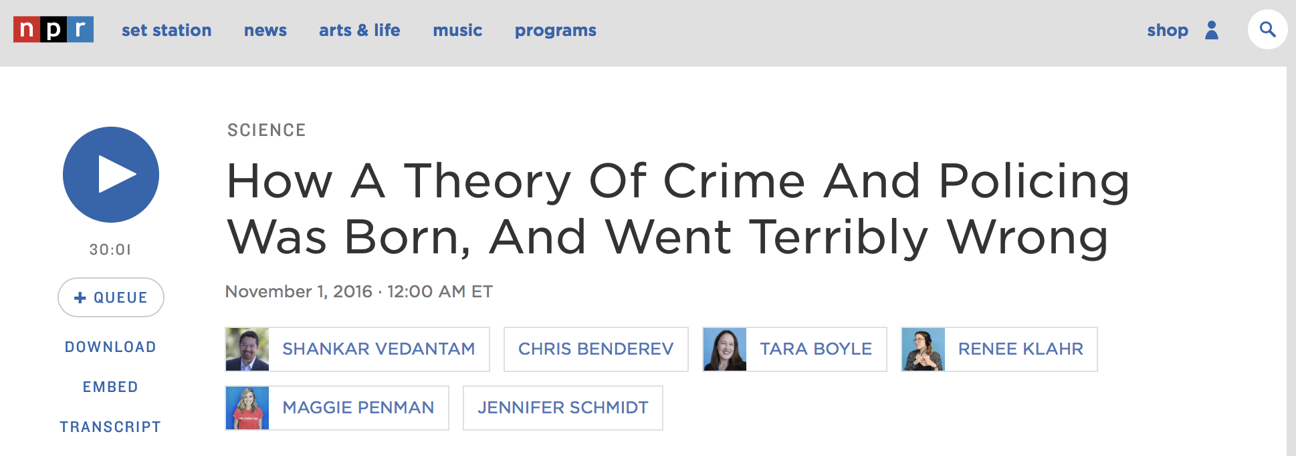
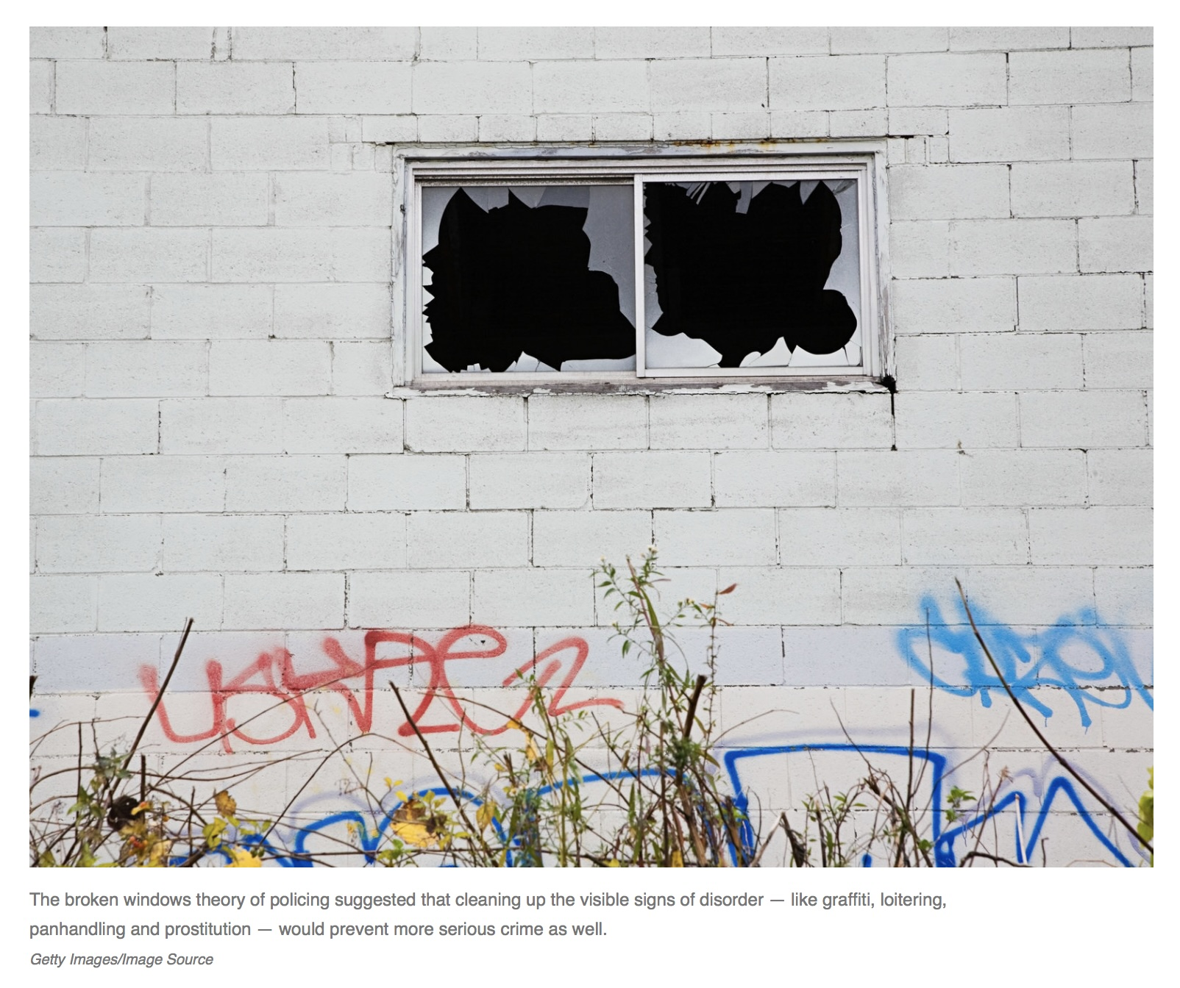
Notes:
As mentioned, Rob Sampson was really railing against broken windows theory as a theory of crime in the sense that neglected physical environments may cause crime, at least.

Slide 24
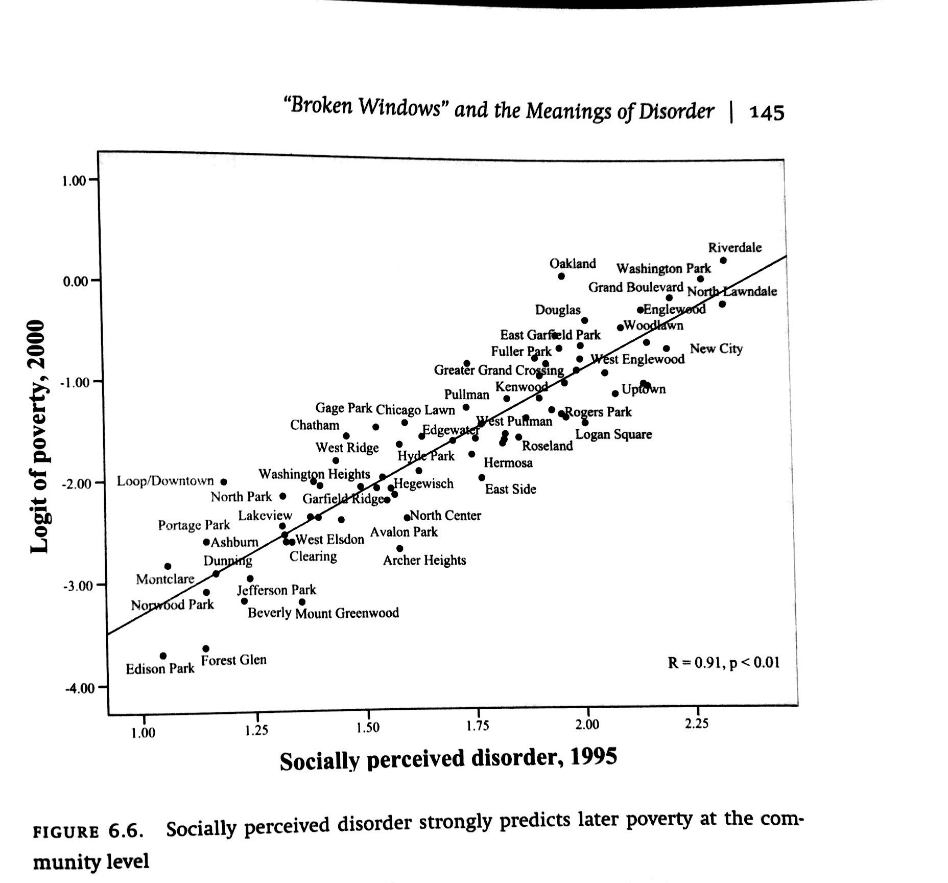
feedback loop
crime +
signs of disorder
-> stigma
segregation
-> crime
neglet
disorder as a dynamical force
Notes:
This relates poverty rates to measures of socially perceived disorder (measured by surveys to residents). Sampson’s point here is to try to show that “social disorder” is more important than “Physical disorder”, though in truth they could be related by higher order processes affecting cognition and behavior, and create vicious cycles.

Slide 25
Collective Efficacy
Residents were asked:
likelihood their neighbors could be counted on to take action if:
1) children skipping school and hanging out out on a street corner
2) children were spray-painting graffiti on a local building
3) children were showing disrespect to an adult
4) a fight broke out in front of their house
5) the fire station closest to their home was threatened with budget cuts
Also asked:
People around here can be trusted
…
Notes:
Here’s how social disorder was measured … please see sources if interested…

Slide 26
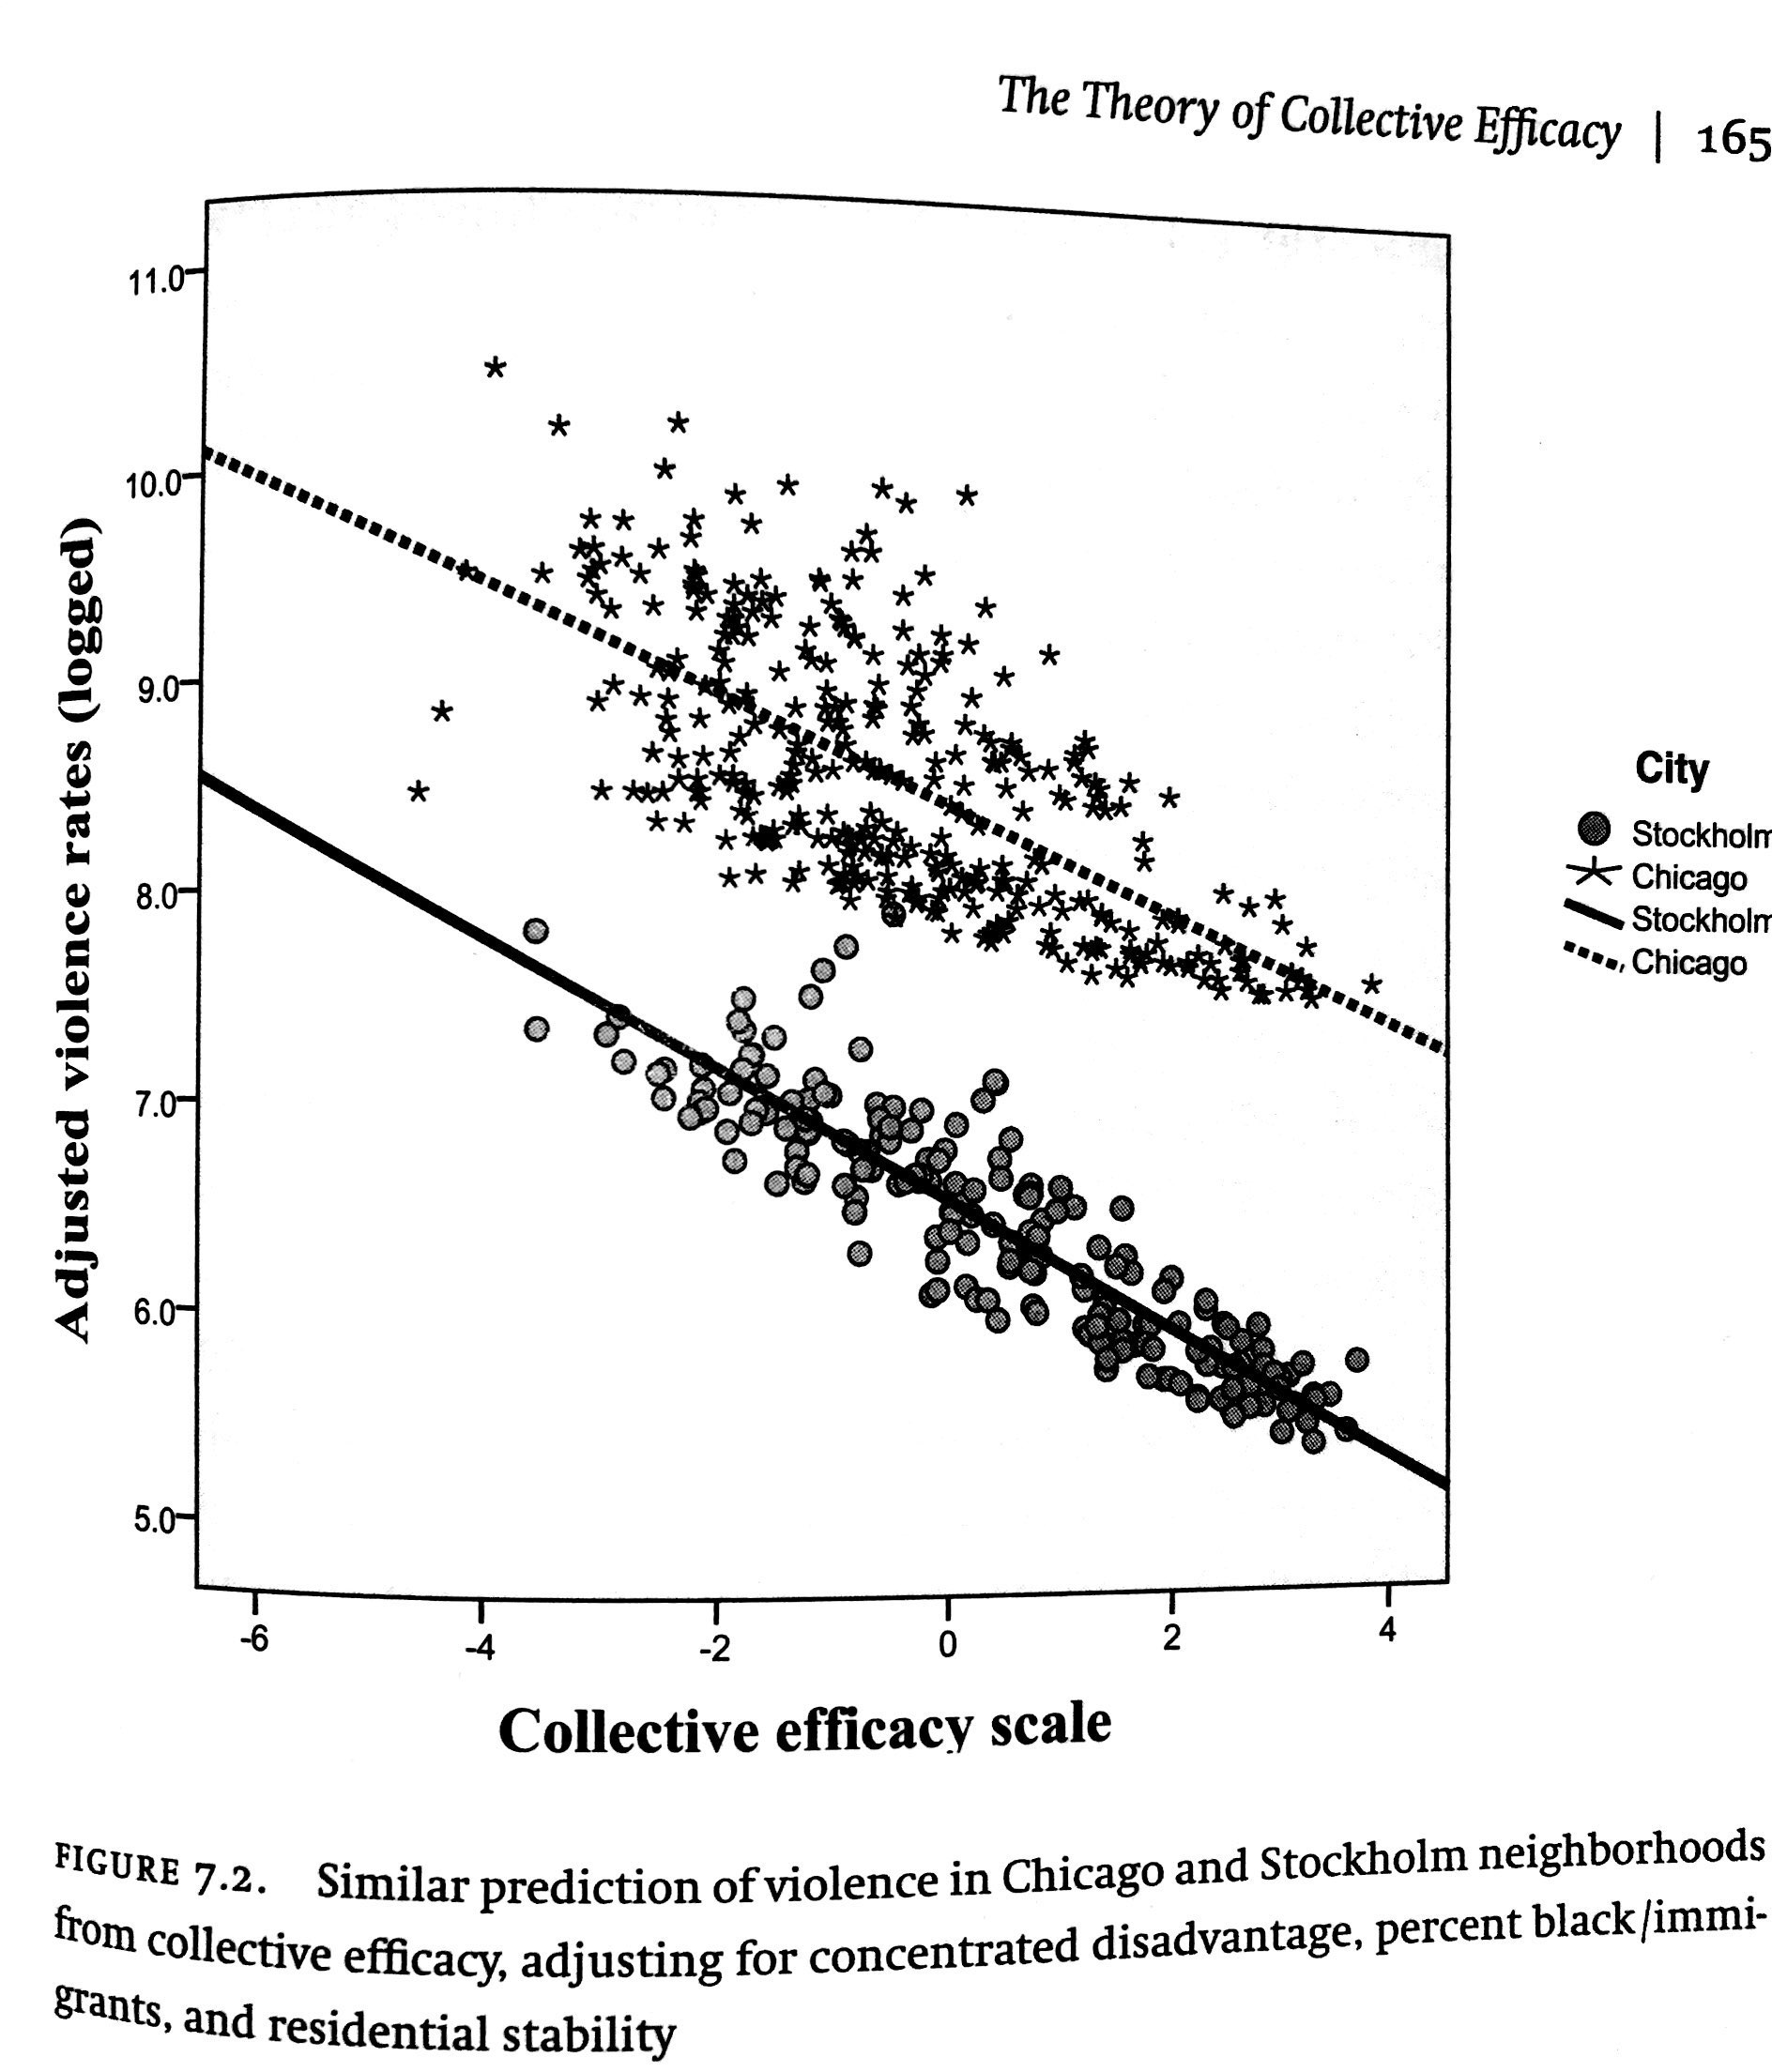
Collective Efficacy
social cohesion
+ shared expectations of control
working trust
and social interaction
every day strategies by which
residents address challenges
Notes:
And here is an attempt at making these statements not just about Chicago, but also about international cities. Note that violence in Stockholm is much lower to begin with… All this is an important tradition in sociology and adjacent disciplines, more recently reinforce by tax data and social media data from other authors. It does not really add up to a quantitative predictive theory, though it has been immensely influential.

